Slide 1
Are you getting the results you want?
The importance of monitoring outcomes
Notes:
Introduce the scale of BFOB 400000 ha in kahurangi last summer. We have to show that we are achieving our conservation goals as a result of this, and be able to do so in a scientifically robust way. The aim of this talk to show you some of the techniques that we use and demonstrate how much more information you get on the effectiveness of your predator control.

Slide 2
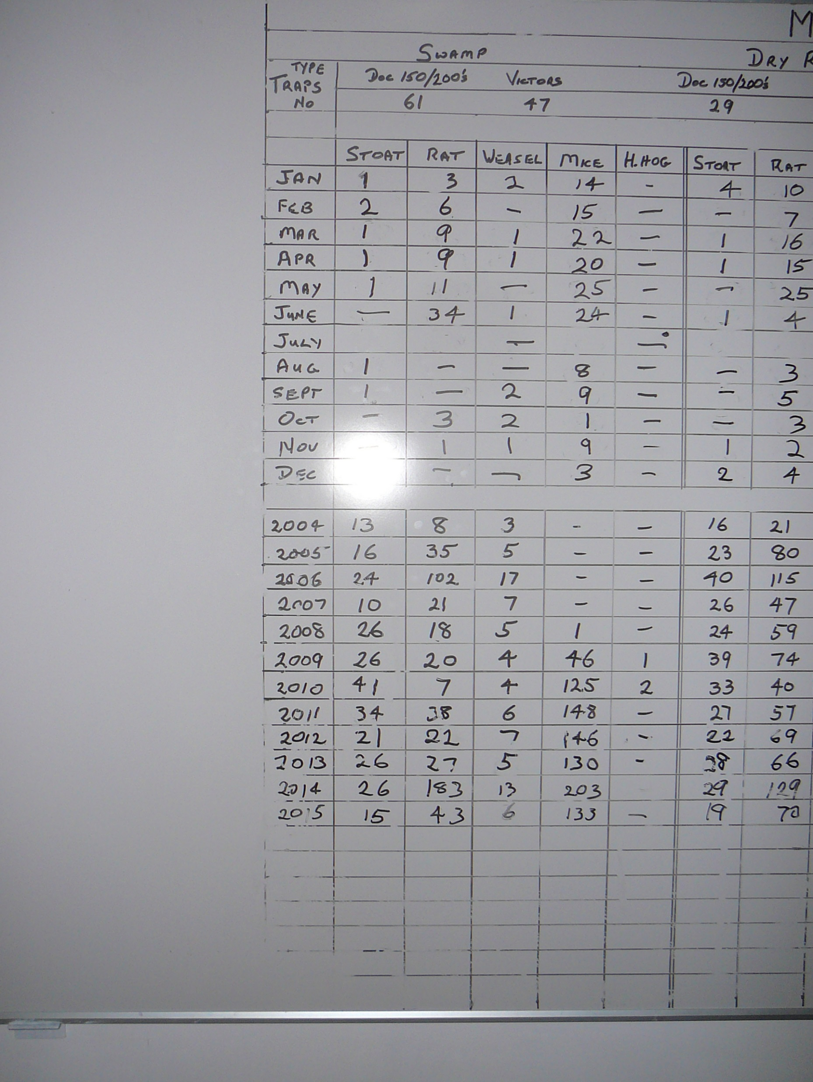
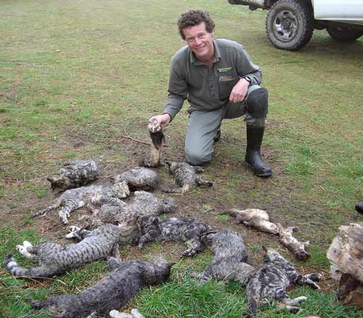
Notes:
So this is the standard way most trapping groups “monitor” these are outputs

Slide 3
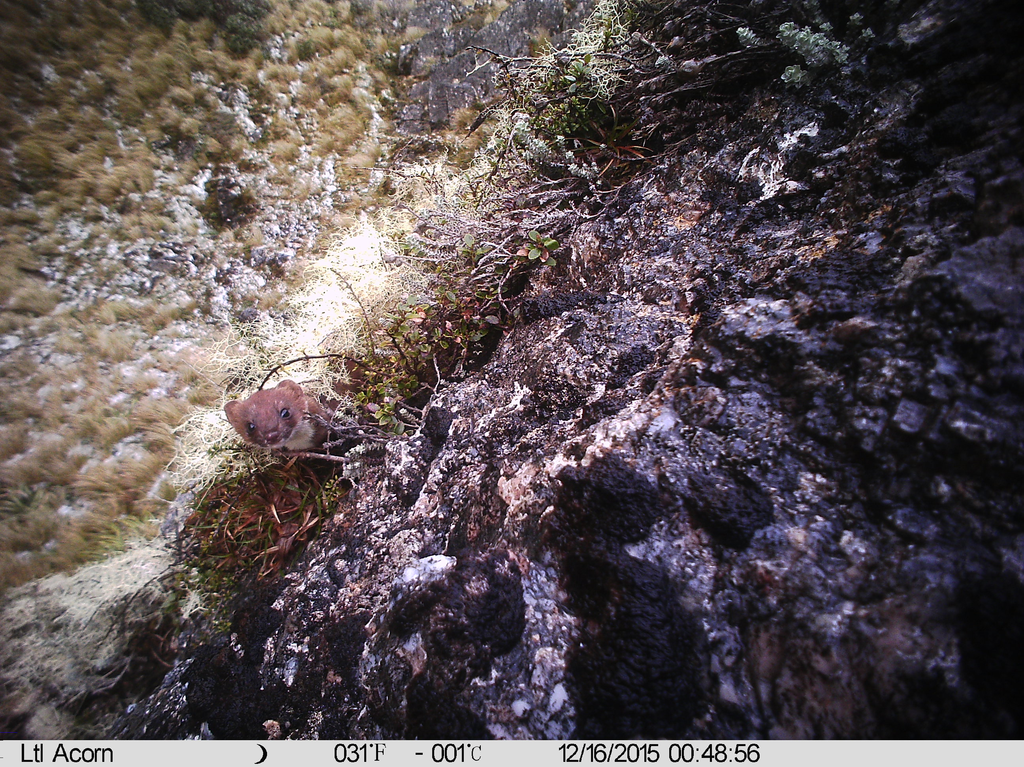
Notes:
We also tend to focus on these guys, because the trap spacings are achievable for most groups.

Slide 4
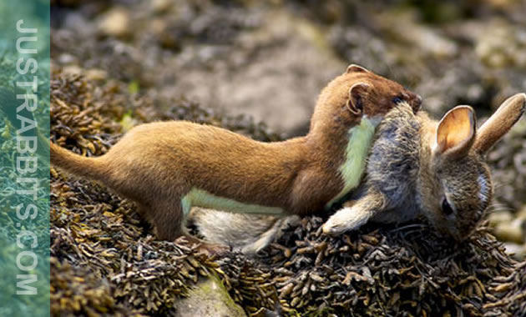
Notes:
We also need to be aware that good intentions do not necessarily result in good conservation outcomes

Slide 5
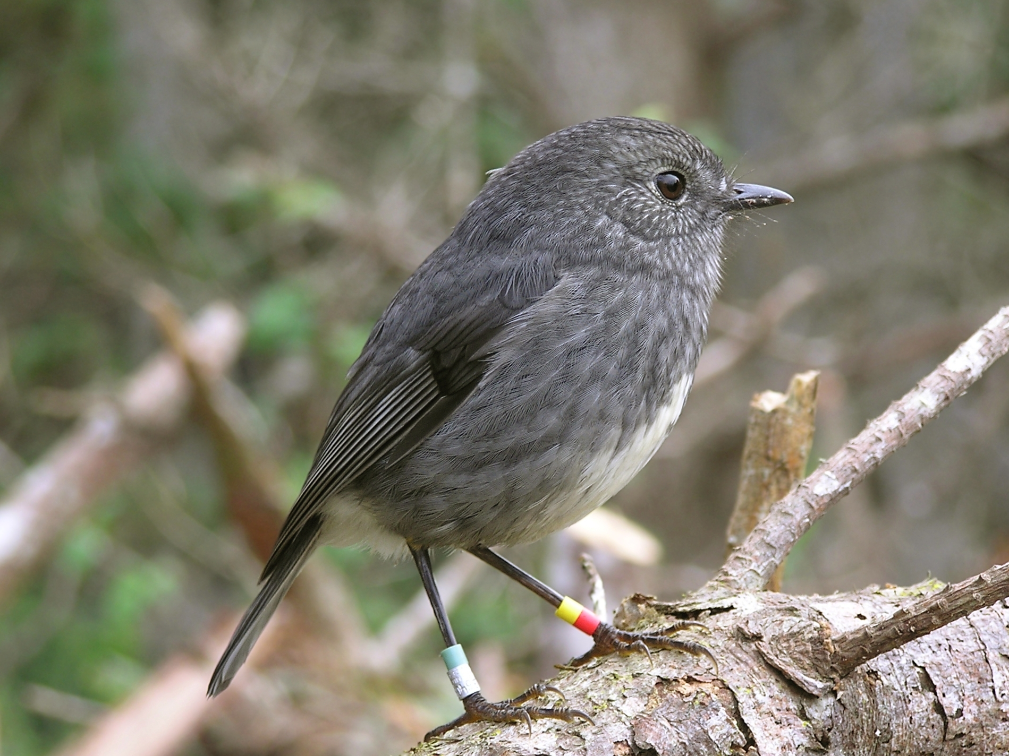
Notes:
But what we need to be aware of is by targeting only stoats we can make things worse for our smaller forest birds

Slide 6
Goal setting
What do you want to achieve?
Be realistic or at least set some mid term goals.
Be aspirational once you know what you are doing
Notes:
So before deciding on how you are going to control predators think about what you want to achieve. Start realistic, then move to something more aspirational once you know what you are doing.

Slide 7
Restoration Monitoring
Are we making a difference and how does this knowledge affect what we do?
Outputs: - measuring what we’ve done
Outcomes: - measuring the end result

Slide 8
Outcomes
Outcomes are two part
Measuring the effect on the predator populations
Tracking tunnels
Wax tags
Chew cards
Pellet counts
RTC
Notes:
Robert from the brook will talk more about these methods this afternoon.

Slide 9
Outcomes
Outcomes are two part
Measuring the effect on bird or plant populations
Call counts
Presence/absence surveys
FBI Index
Distribution surveys

Slide 10
Tracking Tunnels

Slide 11
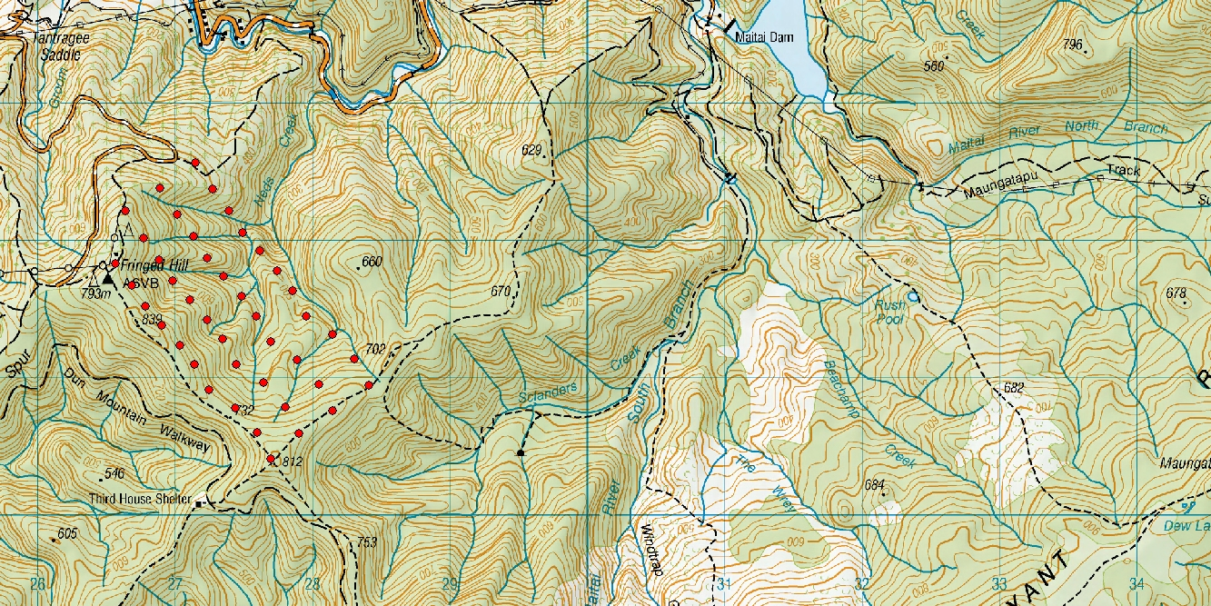
Notes:
Ok so im hoping to show you how much more information you can gain by monitoring outputs. Here a trap network for stoats. Traps a re indicated by the red dots I made it up it dosen’t exist

Slide 12
Notes:
So what kind of conclusions can you draw from this about how effective the trapping program is at reducing stoat numbers? You are probably going to pat yourself on the back and say you have caught lots of stoats and it must be good but all you can say is that you caught some stoats.

Slide 13
Notes:
Now lets put a couple of tracking tunnels in the trapped area

Slide 14
Notes:
So we see the traps required some time to be effective, we see that the high trap catch is supported by the TT network, helpful but not the full story.

Slide 15
Notes:
Lets do one better and put some tracking tunnels in the adjacent un managed area

Slide 16
Notes:
Now we can actually gauge how effective this management is in relation to the surrounding area. So we see the traps required some time to be effective, we see stoat population has huge variation. We also see that when stoat numbers are high (over 50% tracking) the trap network is in effective, signaling the need to increase intensity or scale.

Slide 17
Bird Counts

Slide 18
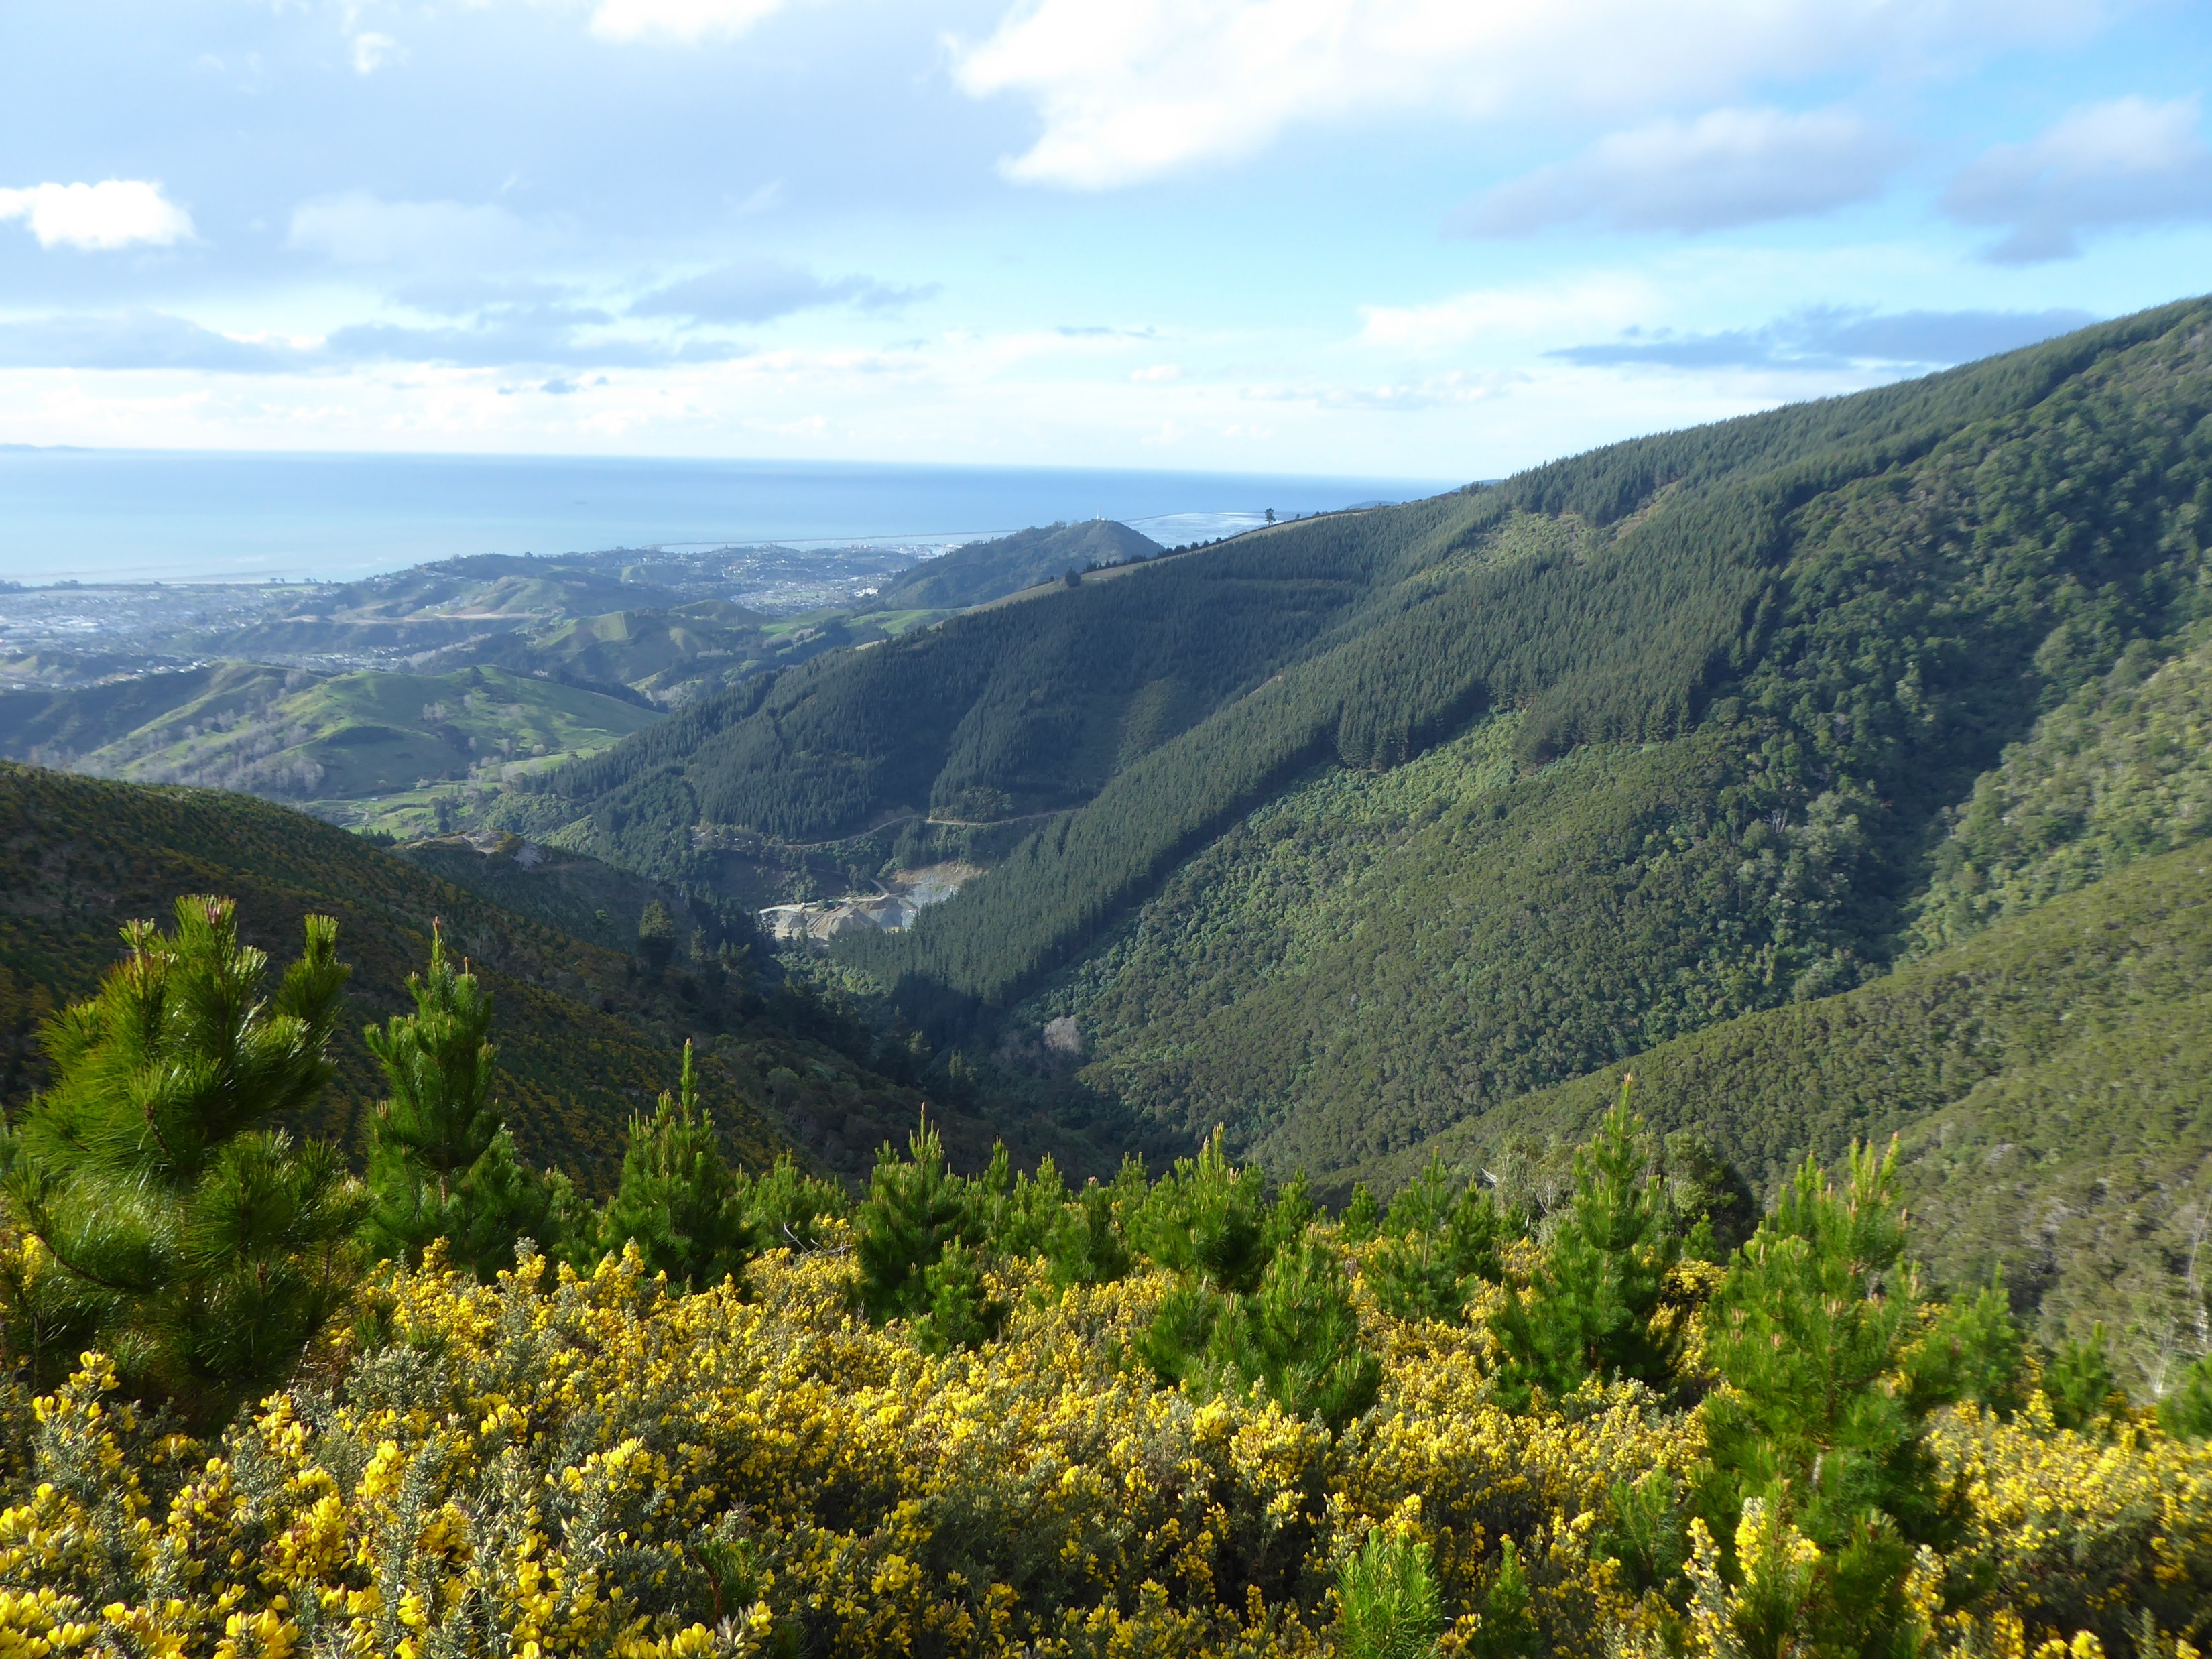
Notes:
So a good nelson example might be I want more small forest birds in the Marsden valley.

Slide 19
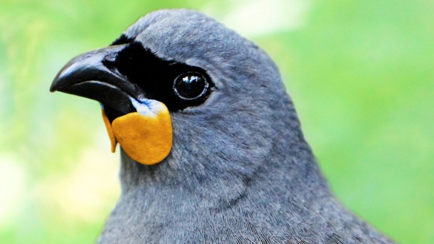
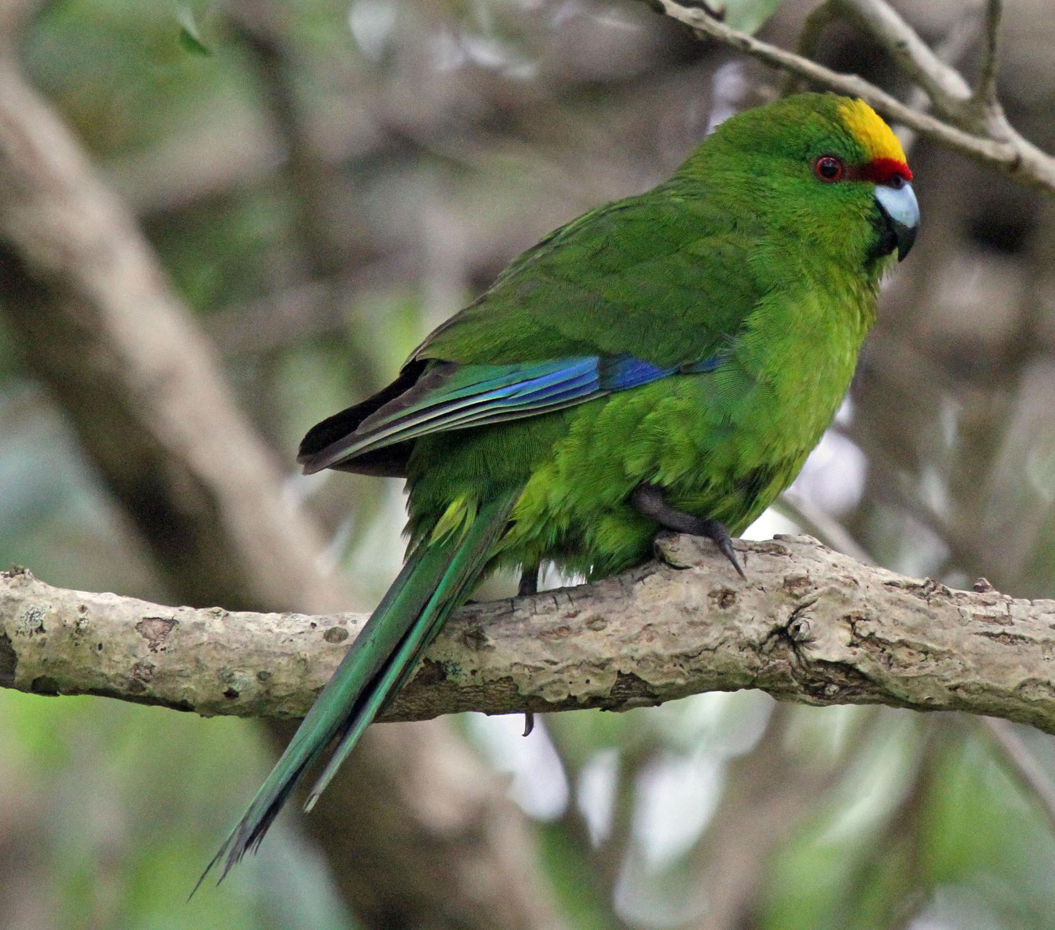
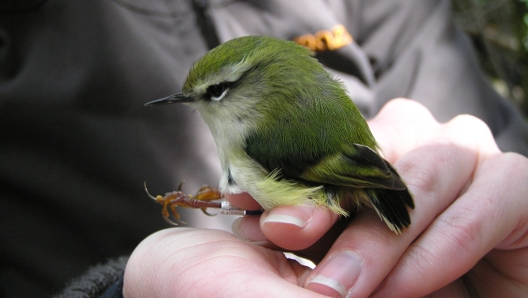
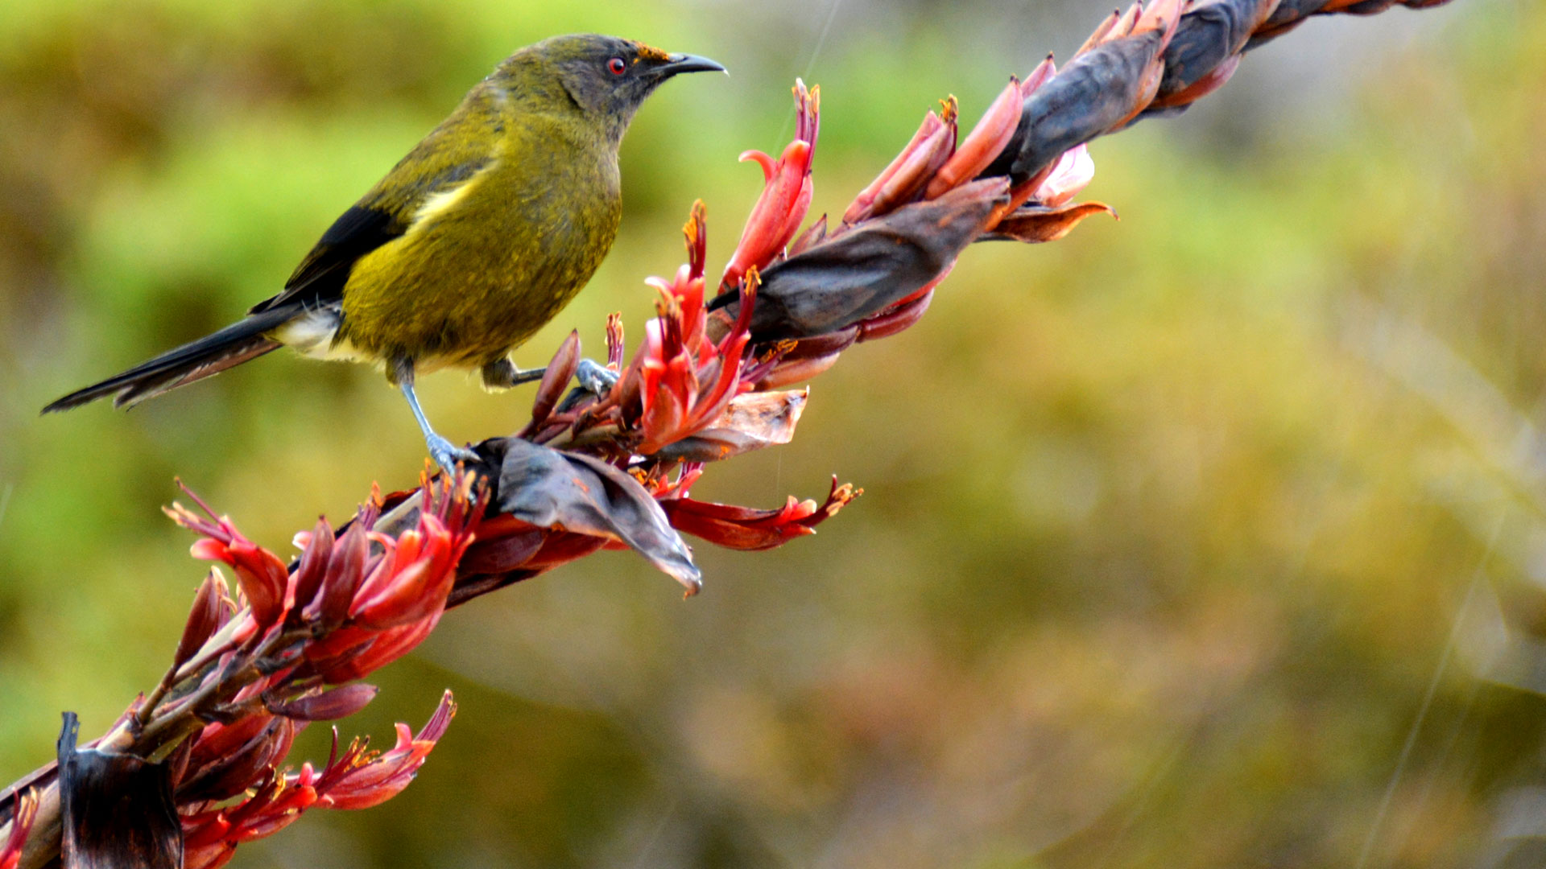
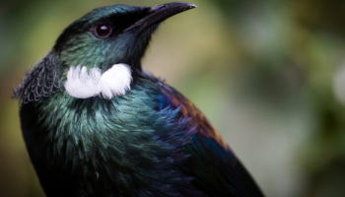
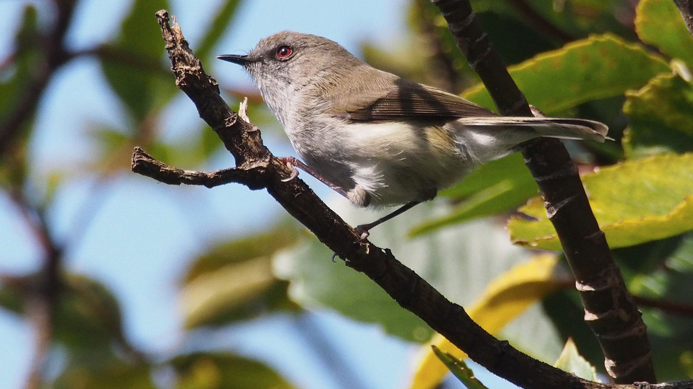
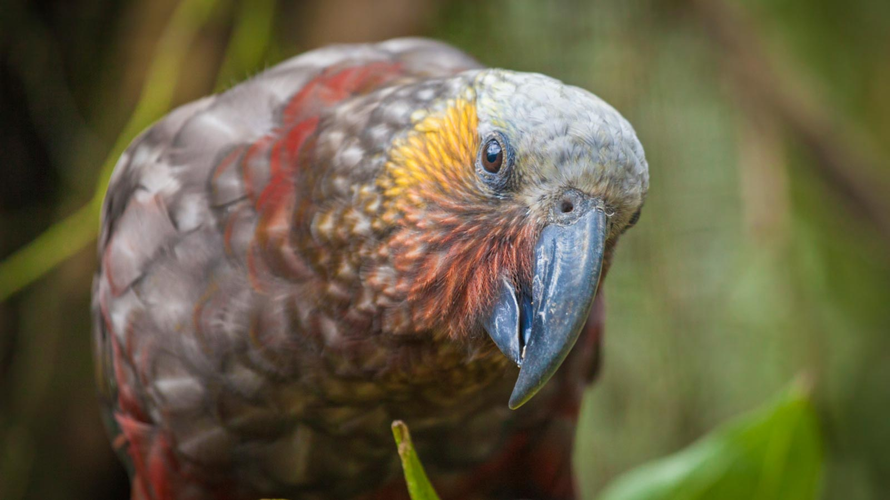
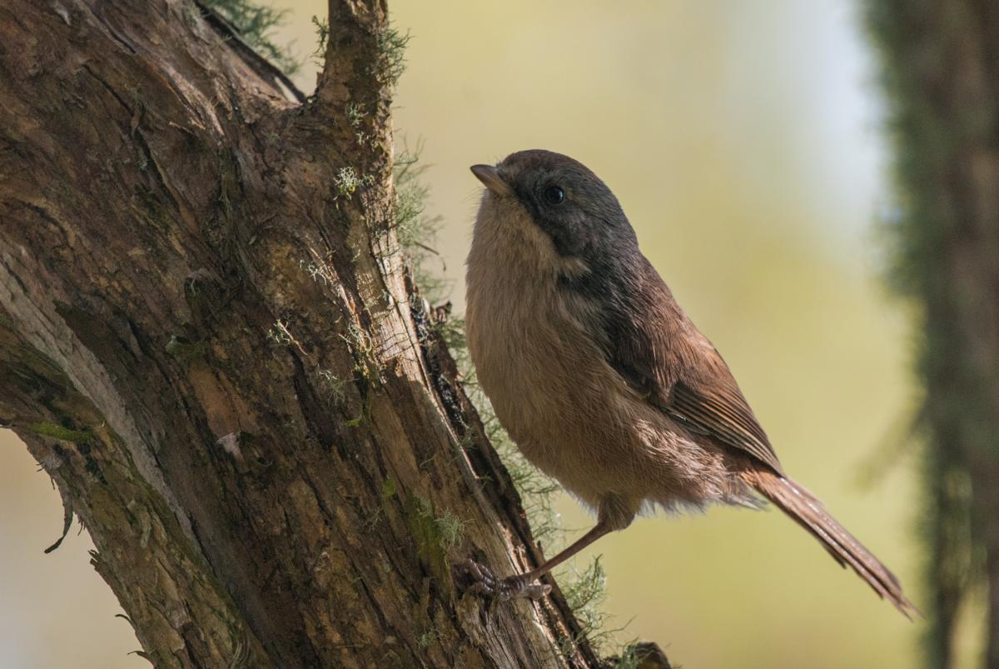
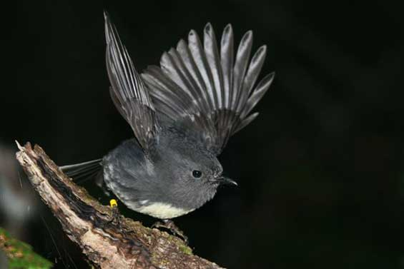
Notes:
Small forest birds are rat and stoat sensitive. Robins are a species that is present at higher altitude but not present down low in the valley. Robins are a good indicator species for the effectiveness of the predator trapping. Don’t pick something that is rare like a kaka or Kokako

Slide 20
Notes:
Small forest birds are rat and stoat sensitive. Robins are a species that is present at higher altitude but not present down low in the valley. Robins are a good indicator species for the effectiveness of the predator trapping. Don’t pick something that is rare like a kaka or Kokako

Slide 21
Notes:
Small forest birds are rat and stoat sensitive. Robins are a species that is present at higher altitude but not present down low in the valley. Robins are a good indicator species for the effectiveness of the predator trapping. Don’t pick something that is rare like a kaka or Kokako

Slide 22
Notes:
Small forest birds are rat and stoat sensitive. Robins are a species that is present at higher altitude but not present down low in the valley. Robins are a good indicator species for the effectiveness of the predator trapping. Don’t pick something that is rare like a kaka or Kokako

Slide 23
Notes:
Small forest birds are rat and stoat sensitive. Robins are a species that is present at higher altitude but not present down low in the valley. Robins are a good indicator species for the effectiveness of the predator trapping. Don’t pick something that is rare like a kaka or Kokako

Slide 24
Notes:
Small forest birds are rat and stoat sensitive. Robins are a species that is present at higher altitude but not present down low in the valley. Robins are a good indicator species for the effectiveness of the predator trapping. Don’t pick something that is rare like a kaka or Kokako

Slide 25
Notes:
Small forest birds are rat and stoat sensitive. Robins are a species that is present at higher altitude but not present down low in the valley. Robins are a good indicator species for the effectiveness of the predator trapping. Don’t pick something that is rare like a kaka or Kokako

Slide 26
Notes:
Small forest birds are rat and stoat sensitive. Robins are a species that is present at higher altitude but not present down low in the valley. Robins are a good indicator species for the effectiveness of the predator trapping. Don’t pick something that is rare like a kaka or Kokako

Slide 27
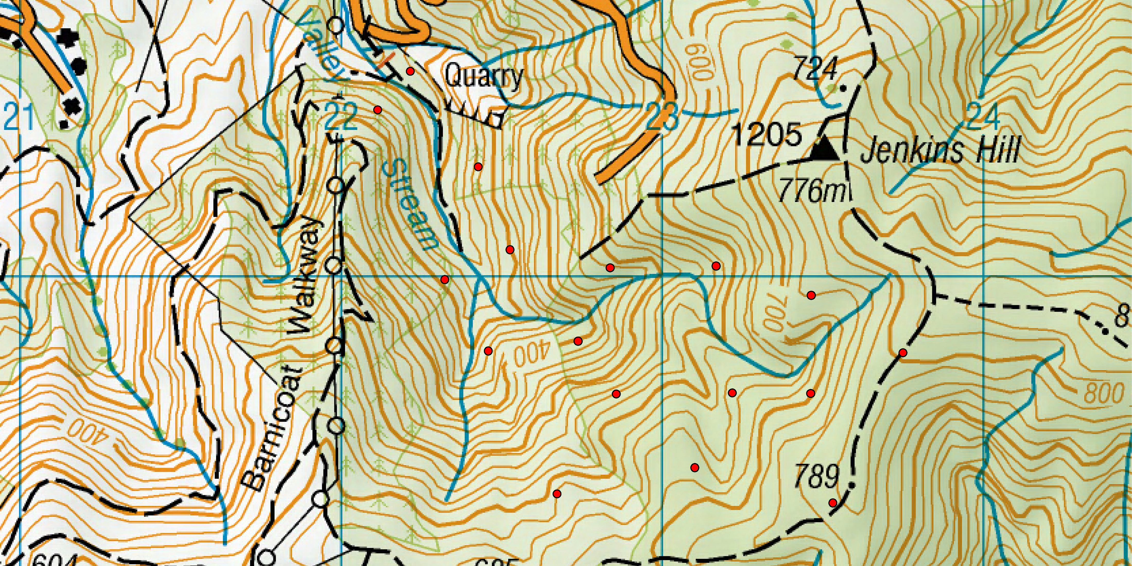
Notes:
Next up you need a monitoring program to assess if your management is achieving what you want. So we are going to monitor Rats, Stoats and Robins. Rats and Stoats are monitored with tracking tunnels placed inside the trapped area and in some adjacent un trapped comparable forest. Robins are monitored at random points within the trapped area with the goal of hearing more of them and more points and at lower altitude. With the assumption being if you make things better for robins you make things better for the less sensitive forest birds.

Slide 28
Restoration Monitoring
conservation management
monitoring results

Slide 29
Some practical suggestions
Measure changes in distribution rather than abundance
Don’t measure what you don’t expect to change
Keep it to the same time of year

Slide 30
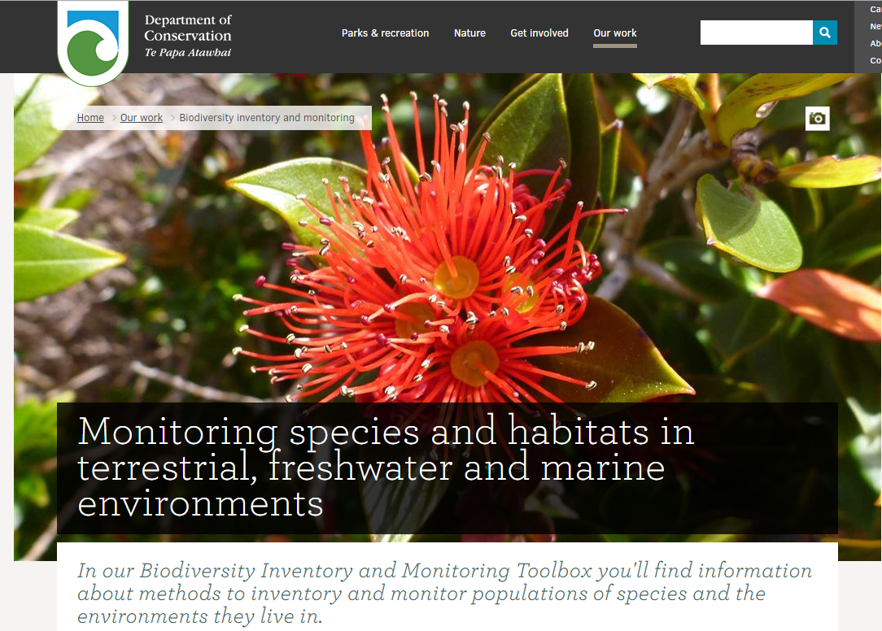
Notes:
DOC website is a good source of best practice information

Slide 31
Be part of something bigger

