Slide 1
Nelson – Planning Our Future series
Financial Security in Retirement
September 2017

Slide 2
What we do at the Commission cffc.org.nz
Capability Programme
Schools
Maori and Pacifica
Employers
50plus
Retirement Income Policy Review
Retirement Villages
Sorted and Digital resources
Media and Stories
Policy and Review
Money Week
Notes:
Behaviour change is possible if we understand what under-pins decision making or lack of it.
CFFC does more than just give out information.
Sorted website goal to be a personal financial assistant, greater ‘robo-planning’

Slide 3
Segmentation – Financial capability
Notes:
Discovery 65-74 Endeavour 75=84 Reflection 85+
Most clients for financial advisers will be in the GP visit phase
Health framework to segment 3.6m Nzers, triage approach to determine who needs what and how to deploy finite resources – based on surveying 4000 people each year and thousands more from engagement activities we do – and project such as Money Week..
Future accommodation needs and choices of growing aged demographic are expected to change.
Barometer-related;
33% of households save money every few weeks, the rest is less , 6% never save
54% of Nzers could access 3 months income via savings or other means(capital)
26% of Nzers have long term financial goals in place

Slide 4
Snapshot of Retirement Trends
Life expectancy is increasing:
Today: 83 years Female (1970: 80) / 79.5 Male
700,000 people over 65 today. Forecast 1.5m in 2050
43% of the 65-69 cohort are working full or part-time.
Around 25% do so because they have to.
Labour force aged 65+ will increase (130,000 – 2012) to 370,000 in 2036 and 460,000 in 2061
Over 60% of those over 65 rely on NZ Super for 80% to 100% of their income – (MSD 2014)
Around 750,000 NZ Super recipients today. Around 1.2m by 2033
Declining home ownership. Around 67% 20-49 year olds do not own their usual residence.
Notes:
Broad message:
Future accommodation needs and choices of growing aged demographic are expected to change
The average age for someone applying for Home Equity Release (with Heartland Seniors Finance) is 72 years of age
Attitudes towards some choices, such as RVs, are expected to change
Traditional investment language about wealth focused on money returns – contrast more about ‘well-being’
Other health and social trends may shape our future accommodation options:
Occupations of those working longer mainly in management, professions, clerical and labourers
Not only is life expectancy going up but so is health expectancy. DALYs (disability adjusted life years = loss of one year of life lived in full health) are improving at 1.2% per year (while the total number of DALYs goes up as our population goes up and ages).
Health adjusted life expectancy (# of years an average person can expect to live in full health) is going up.
NZers are living longer in good health but they are also living longer in poor health. This is because life expectancy is rising faster than health expectancy. Morbidity is expanding there for as life expectancy grows faster than healthy life expectancy or independent life expectancy. Of the extra years of life expectancy 80% is spent in good health and 20% in poor health.

Slide 5
Snapshot of Retirement Trends
Estimated by 2050: 100% increase; 60,000 – 80,000 people living in retirement villages
12.5% of people over 75 years currently live in Retirement Villages ( RVs are not rest homes!)
Estimated 20% growth between 2025-30 in number needing residential care, we need at least 58000 more residential care beds by 2030
50,000 dementia sufferers today – will triple by 2050
Average tenure of needs-assessed rest home care residents is 18-24 months.
Residential care subsidy eligibility thresholds mean most home-owners may need to asset strip to pay for their care.
75% of elder abuse cases involve family members (Age Concern – Elder Abuse Awareness)
Notes:
Broad message:
Future accommodation needs and choices of growing aged demographic are expected to change
The average age for someone applying for Home Equity Release (with Heartland Seniors Finance) is 72 years of age
Attitudes towards some choices, such as RVs, are expected to change
Traditional investment language about wealth focused on money returns – contrast more about ‘well-being’
Other health and social trends may shape our future accommodation options:
The number of people aged 85 years and older will more than triple, from about 83,000 in 2016, to between 270,000 and 320,000 in the next 30 years. Those aged 65 years and older will roughly double, from about 700,000 now to between 1.3 and 1.5 million in 2046.
Rising cost of residential care: Around 950m in DHB payments last year v 750m paid by residents. Half of DHB payments for hospital care, about ¼ for resthome.

Slide 6
Trends – What it all means…
We are living longer, in good health or in bad
We are most likely going to be working longer
We need our income to live as long as we do
We should understand words like ‘Decumulation’
Know how and where to get advice and information
Build a plan, know what it should have in it
No ‘one size fits all’ answer

Slide 7
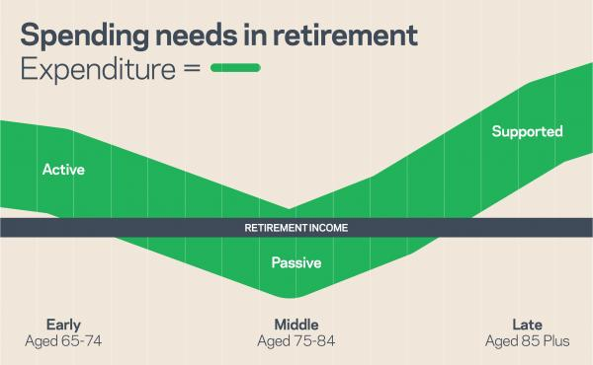
Trends – What it all means…
Spending varies in retirement. Spending is not in a straight line through the three stages of retirement
Notes:
Retirement Income Policy review – increasing retirement eligibility age or number of years you need to be in NZ before getting entitlement to super = matter of active political debate
Issue with declining home ownership – traditional asset rich / income poor scenario = housing for lower income NZers
Many people use friends or family for advice but note the elder abuse statistics show 75% of elder abuse is by family member / relative
Use a Financial Advisor to sort a CAPITAL draw down plan. Your income needs over three stages of retirement will change. You may have enough for passive income for the first stage and then start drawing down on Capital.
Find an advisor via the Institute of Financial Advisors . Review of the law will see all advisors authorised but with clear categories they can advise in. Reinstating the bar for fiduciary duties.
CFFC has 10m funding for driving financial capability in schools to tackle the needs of the next generation

Slide 8
What are your income options from 65?
Salary or wages / Self-employment or business
National Super
Other Government benefits (housing subsidies etc ..)
Bank deposits
Rental income from property (boarders, tenants, Air BnB)
Indirect investments – managed funds, company super schemes, third party investments
Direct investments – shares, bonds, other investments
Your kids… yeah right ☺
High interest rate returns (20+%) like the 1986 levels are unlikely in near future…

Slide 9
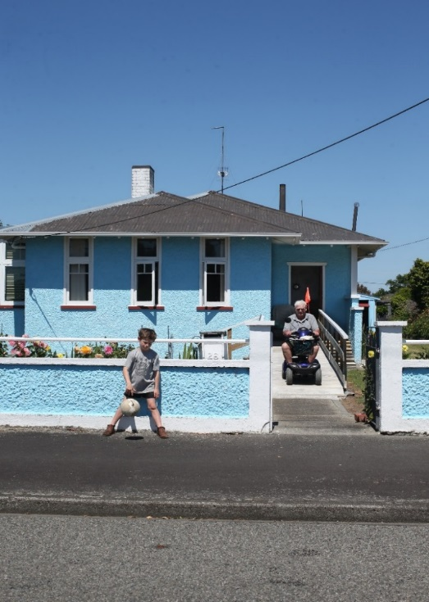
Decumulation?
Capital drawdown of KiwiSaver
Capital drawdown of other investments like Bank TD, managed funds and direct investments
Shifting locations/‘right-sizing’ your own home releasing capital
Family buying into your residential home
Annuities – Lifetimes Income
Moving to a Retirement Village
Equity release mortgages
Notes:
Having a capital fund generating income AND being prepared to eat into the capital
Longevity is the key.
You need an income in retirement that stays stable across a low % return environment. Bank interest alone won’t do it.
Need a plan or to change your circumstances, such as through decumulating to right size or go into a RV.

Slide 10
Annuities
Lifetime Retirement Income - http://www.lifetimeincome.co.nz/
Savings invested in a balanced fund provide guaranteed income for a fixed period / life regardless of how the fund performs
Can receive payments from 65 or defer when you start receiving them
Fund purchases ‘longevity insurance’ so you continue to receive income if you outlive original capital
Any remaining capital in Fund is paid to your estate on your death (or transferred to surviving spouse for their life)
Notes:
the Retirement Income Group has New Zealand's first annuity aimed at KiwiSavers.
Annuities provide an income for life, guaranteeing that retirees' money won't run out before they die.
In effect an annuity combines investment with longevity insurance.
Whatever happens in the market, you get regular income from the nest egg you invested. Your income level is insured to last as long as you do.
With traditional annuities the retiree takes the lump sum and hands it over to an insurance company, which guarantees a regular payment to the retiree until he or she dies.
On death any money left is the property of the insurance company and isn't paid out to the estate. The sooner the retiree dies the more profit the insurance company makes

Slide 11
Annuities
The initial money you invest, minus any Adviser service fees you agree to pay, is called your Protected Income Base
You can invest anything from a minimum of $100,000 to a maximum of $1,000,000
You cannot draw an income until you’re 65
The insured income is called your Lifetime Withdrawal Benefit - calculated from the size of your Protected Income Base and the age at which you begin your income payment.

Slide 12
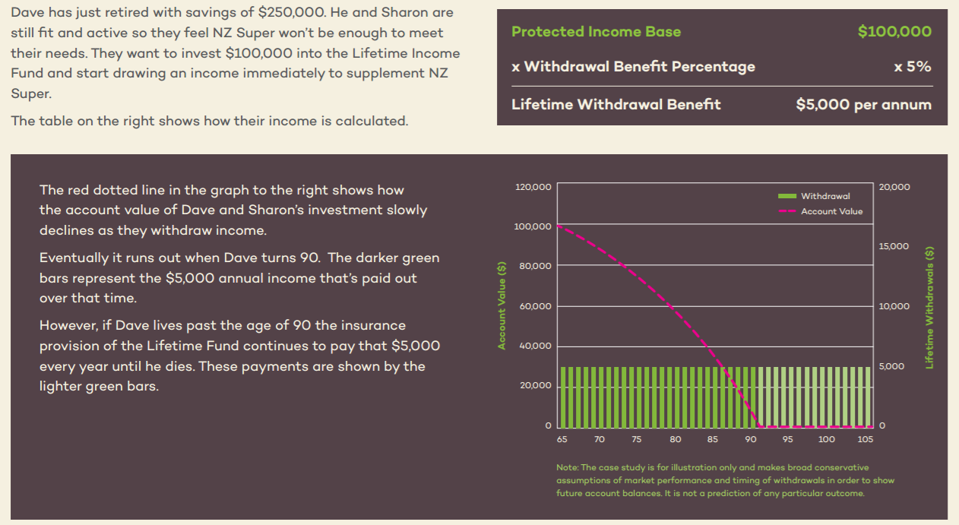
Annuities

Slide 13
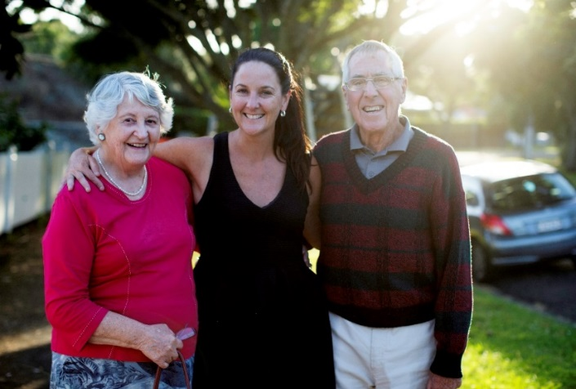
Equity Release Mortgages
Amount you can borrow depends on age, home value, being debt free to start. Fees apply
Designed specifically for seniors with no regular re-payments
Enable seniors to continue living in their home and benefit from any increase in value
Free up some cash to enjoy a better retirement
Total amount you draw plus accumulated interest is repayable when you sell or permanently move from your home.

Slide 14
Equity Release Mortgages
Compounding interest on lump sum drawn down may eat into value of your home faster.
May be OK in appreciating market conditions but less so in declining markets
Fixing a regular smaller payment amount may be better option. Interest calculated on balance drawn down.
Often only a modest amount makes a big difference
Keep occupancy of your home
No negative equity guarantee
Robust fulfilment process including mandatory independent legal advice
Notes:
Reverse mortgages generally come with a lifetime occupancy guarantee, which gives borrowers the right to live in their home for as long as they choose. They also usually offer a “no negative equity” guarantee that ensures that you –or your estate – won’t have to repay more than what your house sells for. You won’t be leaving your children with a debt if the house sells for less than the amount of the outstanding loan.

Slide 15
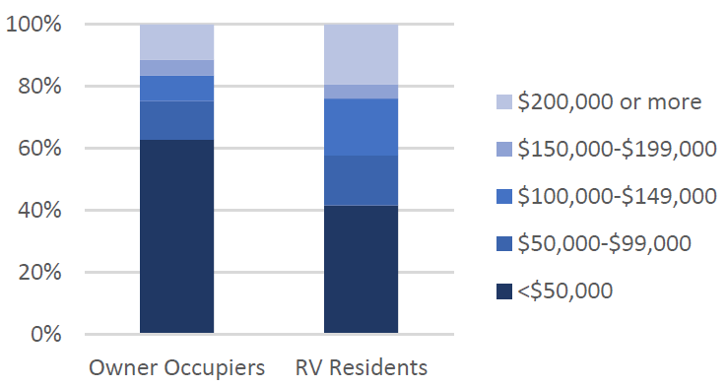
Equity Release – Moving to a Retirement Village
A survey showed how much cash they had left over after buying into their village (equity released from the sale of their home). 20% had over $200,000.
Overall 42% had more than $100,000 to supplement their lifestyle.
Know the entry costs, costs while you are there (different weekly fee models) and exit costs.
Most villages retain up to 30% of your original capital when you terminate your occupancy.
Source: CRESA: Equity Release – Realities for Older People – August 2016
Notes:
Range of net wealth positions
So you Don’t need to be hugely wealthy to consider RV?
Not a traditional investment. Lifestyle related considerations. Different tenure.
Briefly describe cost implications. Lock-in risk..

Slide 16
Wills and Estates
Update your will and review your estate planning - Personal and financial circumstances change.
Avoid claim risks: Family Protection Act / Testamentary Promises Act
Things to consider relative to family and assets:
Executor / Trustee
Appointing family and/or professional
Estate administration fees
Ways to leave property
Life interests, equal vs unequal shares
Trusts
General or specific gifts
Testamentary debts and funeral expenses
Notes:
endoflife.services.govt.nz
Support for family

Slide 17
Scams - Support
You can get help and support from :
MBIE/Scam Watch www.scamwatch.govt.nz
The DIA www.dia.govt.nz
NetSafe www.netsafe.org.nz
Financial Service Providers Register https://www.fma.govt.nz/help-me-invest/risks-involved-in-investing/being-alertto- scams/checking-the-financial-service-providers-register/
Banking Ombudsman Scheme https://bankomb.org.nz/news-and-publications/quick-guides/item/financial-abuse-of-the-elderly

