Slide 1
2022 Elections for Nelson City Council
Warwick Lampp
Chief Electoral Officer | Āphia Pōti Matua – electionz.com
NCC Electoral Officer

Slide 2
Pōti Tīma | Electoral Team
electionz.com Ltd contracted by Nelson City Council
Warwick Lampp - NCC Electoral Officer | Āpiha Pōti Matua
Devorah (Devi) Nícuarta-Smith - NCC Deputy Electoral Officer | Kaiwhakahaere Āpiha Pōti

Slide 3
Ko wai a electionz.com? | Who are electionz.com?
Warwick Lampp, Electoral Officer, lives in Tauranga
Election services company based in Ōtautahi Christchurch
10 full time staff
Average 200 elections in NZ each year
Electoral Officer (EO) for 39 councils, 6 regional councils
Carrying out vote processing for 45 councils, approx 725K returned voting papers
Vote Processing centre in Ōtautahi Christchurch
Electoral Officer for:
Bay of Plenty, Greater Wellington, Canterbury, Otago, Southland, West Coast
Tauranga, Rotorua, Matamata-Piako, Taupō, Waipā, Ōtorohanga, Waitomo, South Waikato, Ruapehu, Rangītikei, Manawatū, Whanganui, Horowhenua, Napier, Hastings, Central Hawkes Bay, Carterton, Wellington, Masterton, South Wairarapa, Upper Hutt, Nelson, Tasman, Westland, Grey, Kaikōura, Hurunui, Waimakariri, Selwyn, Ashburton, Mackenzie, Waimate, Waitaki, Dunedin, Central Otago, Gore, Southland, Invercargill

Slide 5
Ngā whakamahuki ā Ngā Pou Kaunihera What is Local Government all about?
It’s a complex business!
Underpinned by more than 125 pieces of legislation, Council is responsible for:
Formulating the District’s strategic direction in conjunction with the community through the Long Term Plan (LTP) and reporting on progress
Determining the services and activities to be undertaken by the Council
Managing regulations and upholding the law, including the formulation and enforcement of bylaws
Advocating on behalf of the local community with central government, other local authorities and other agencies
Environmental management through the District Plan
Ensuring local communities are encouraged to be part of the decision-making processes of local government

Slide 6
He aha te take o ngā tāngata kaunihera? What is being an elected member all about? IT IS A BIG DEAL!
Standing for Council takes a strong commitment, it is not a “5-minute job”
Not to be taken lightly, it is an important responsibility
Represent and lead the district – eyes and ears
Advocacy and governance
Skill set in candidate handbook – pages 6 and 7

Slide 7
Pārongo tūranga mahi | Job description
Represent interests of Council and the Community
Formulate strategic direction and priorities
Determine expenditure and funding
Monitor performance
Develop and oversee policy
Ensure prudent use of council resources
Employ and monitor the Chief Executive (CE) only

Slide 8
Whanonga pono me ngā tikanga | Core competencies
Genuine interest for issues faced by local communities
Relate to wide range of people – strong people skills
Competent listening and public speaking skills
Express ideas clearly and be results focussed
Understand, analyse and resolve complex issues
Understand governance versus management
Councillors think “district-wide” on issues
Commit to members’ Code of Conduct

Slide 9
Ngā hui Kaunihera | Council meetings
Council and Committee meetings currently generally held on Tuesdays and Thursdays every week
Usually start at 9am and go for 6-8 hours
Total 82 meetings for 2021/22
Generally mayor is full time job, councillor is approx 3- 5 days per week
Lots of reading of reports and agendas (often hundreds of pages)
Flexible working hours – evening and weekend work required

Slide 10
Utu ā-tau | Remuneration post-election 2022
Mayor $149, 909 pa
Councillor $40, 083 pa minimum base
Paid fortnightly

Slide 12
Ngā Tūranga me ngā Kawenga Āpiha Pōti Matua Electoral Officer Role and Responsibilities
The Electoral Officer (EO) is solely responsible for the conduct of the election
The EO is not subject to the directions of any local authority, elected members, or the CE
Provides a level playing field for all candidates
NB Not responsible for monitoring campaigning by candidates. Only deals with alleged breaches of the Act by passing them to the Police.

Slide 13
Wātaka Pōti | Election Timetable
Election Period starts 8 July (Friday)
Nominations open 15 July (Friday)
Electoral signs can go up 8 August (Friday – 2 months prior)
Nominations close 12 noon, 12 August (Friday)
Delivery of voting papers 16 – 21 September (Friday - Wednesday)
Special voting period 16 September to 8 October
Close of voting 12 noon, 8 October (Saturday)
Progress results available 8 October, approx 3pm
Removal of election signs by midnight on 7 October (Friday)
Official declaration likely to be 13 October (Thursday)
Candidate expenses deadline probably 8 December (Thursday)

Slide 14
STV (Single Transferable Vote)
Nelson City Council’s election is STV in 2022
STV is all about ranking candidates you wish to vote for in your order of preference, i.e.:
Write a “1” beside the name of your most preferred candidate
Write a “2” beside the name of your second most preferred candidate, and so on….
You can rank as many or as few candidates as you wish
If there is someone you don’t want elected at all, don’t give them a ranking
You must only write one number 1, one number 2 etc.
You must not give the same ranking to more than one candidate
Do not vote with a ✗ or a ✓
If a sequence is broken or doubled up, rankings up to that point are counted

Slide 16
Ngā Take Pōti | Nominations will be called for:
Koromatua | Mayor
Kaikaunihera | Councillors - 12 councillors
Stoke-Tāhunanui Ward 4 councillors
Central Ward 4 councillors
Whakatū Māori Ward 1 councillor
Council At Large 3 councillors
All candidate names are in random order

Slide 17
Whakaaringa | Nomination Process
Nomination Period – 4 weeks
Nominations open Friday 15 July
Nominations close at midday Friday 12 August
All nomination documents must be submitted together
Nomination paper, profile statement, photo, evidence of $200 deposit
Must provide evidence of NZ Citizenship (passport, birth certificate)
Must come to NCC customer service centre if in person, can be scanned and emailed to the DEO at elections@ncc.govt.nz
Will accept online banking of deposits – evidence required
Cheques will not be accepted
Nomination paper includes warning for candidates to be aware that contact details will be public info
Can use commonly used name on voting papers – but no titles
Party affiliations – cannot be offensive, confusing, or too long

Slide 18
Whakaaringa | Nomination Process (continued)
Candidate must state if standing in any other elections
Mayor, Ward, Comm Bd, LTs, other TAs?
Is shown at top of profile statement
Is not included in the 150 words
Applies to standing anywhere in Aotearoa New Zealand
Must update earlier nomination form if not included
Nomination paper is a public document, open for inspection
Candidate must state if reside in area of election or not
My principal place of residence is WITHIN / is NOT WITHIN the area
Is shown at the top of the profile statement
Is not included in the 150 words

Slide 19
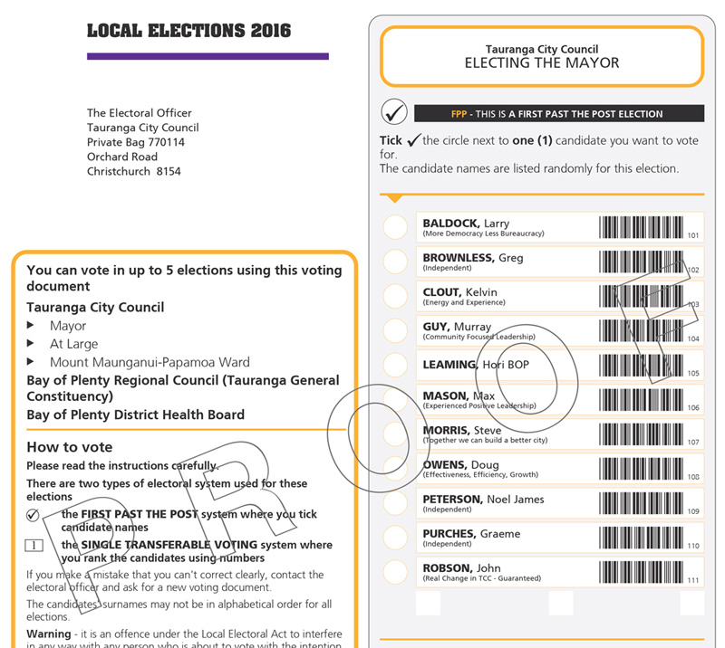
Pepa Pōti | Voting Paper

Slide 20
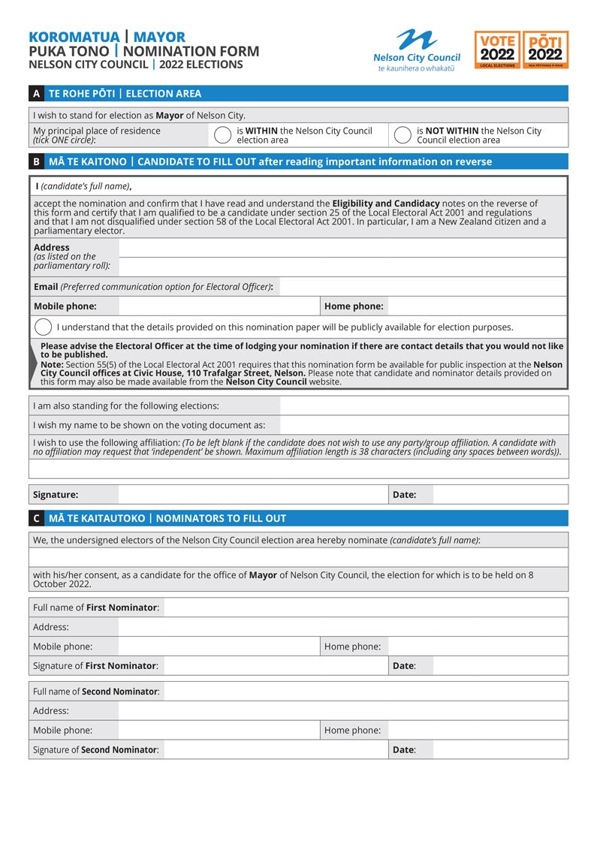
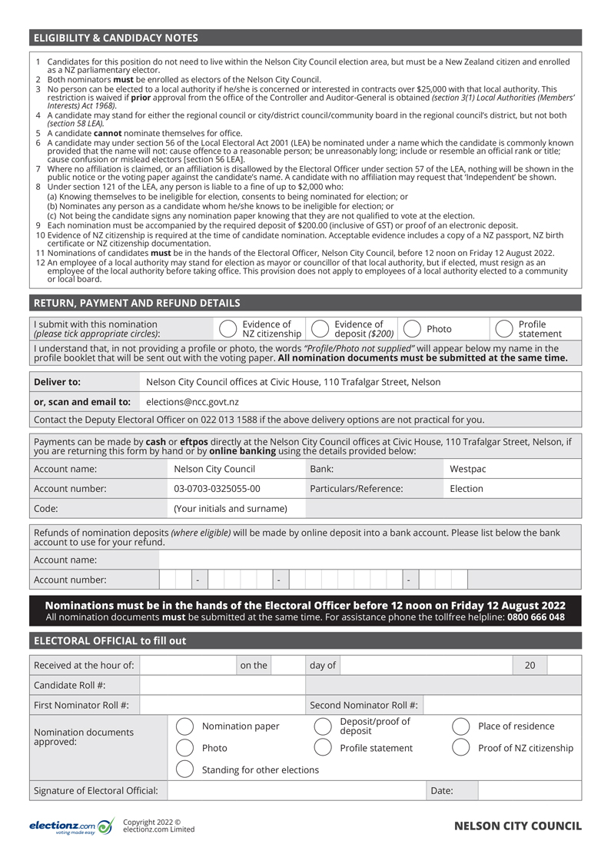

Slide 21
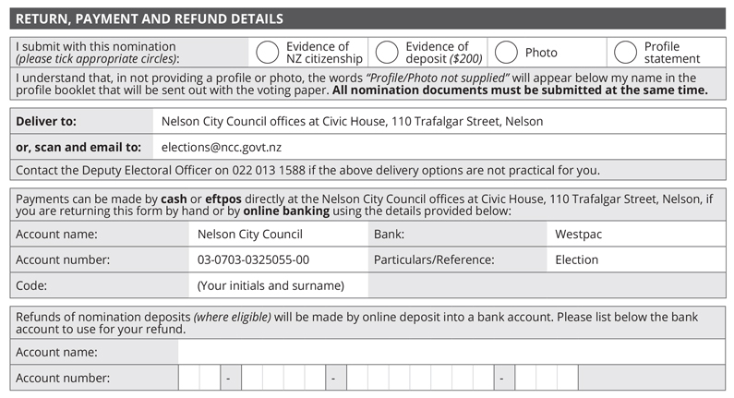

Slide 22
Te Paearu Kaitono | Candidate Qualifications
MUST BE:
A New Zealand citizen (required to provide evidence)
Enrolled on the parliamentary electoral roll (in NZ)
Nominator and seconder on the roll in the area
CANNOT:
Stand for a ward and At Large at the same time
Be serving a prison sentence of three or more years
Have interest in a contract over $25K per year with council
CAN STAND:
For both mayor and councillor, or another council
For the Māori ward if non-maori or on the general roll
If a council employee, but must resign if elected as mayor or councillor
If you live outside area, but must state that on nomination paper

Slide 23
Ngā Maunu Kaitono | Candidate Withdrawals
A candidate cannot strategically or politically withdraw after nominations have closed
Same as for parliamentary elections, i.e. death or incapacity only
Medical certificate required – deposit refunded
Withdrawal application can be made by candidate or their agent

Slide 24
Ngā kōrero whaitake me ngā whakaahua a te Kaitono Candidate Profile Statements and Photos
Profiles
May be provided (not mandatory) – see page 16
must be provided electronically with the other nomination documents as a MS Word doc, not a pdf, not hand-written
Up to 150 words about the candidate, their policies and intentions
Cannot comment on policies etc of any other candidate
Can be emailed to the DEO but hard copies must be attached to nom paper, i.e. all docs submitted together
EO not required to verify or investigate any information included in profile
Profiles on council website as soon as ready after close of nominations
Candidate contact details on council website after close of nominations
Photos
Photos in colour, within last 12 months, head and shoulders shot only (no hats, sunglasses, children, pets or friends)
Photos provided as jpgs, scanned at 300 dpi

Slide 25
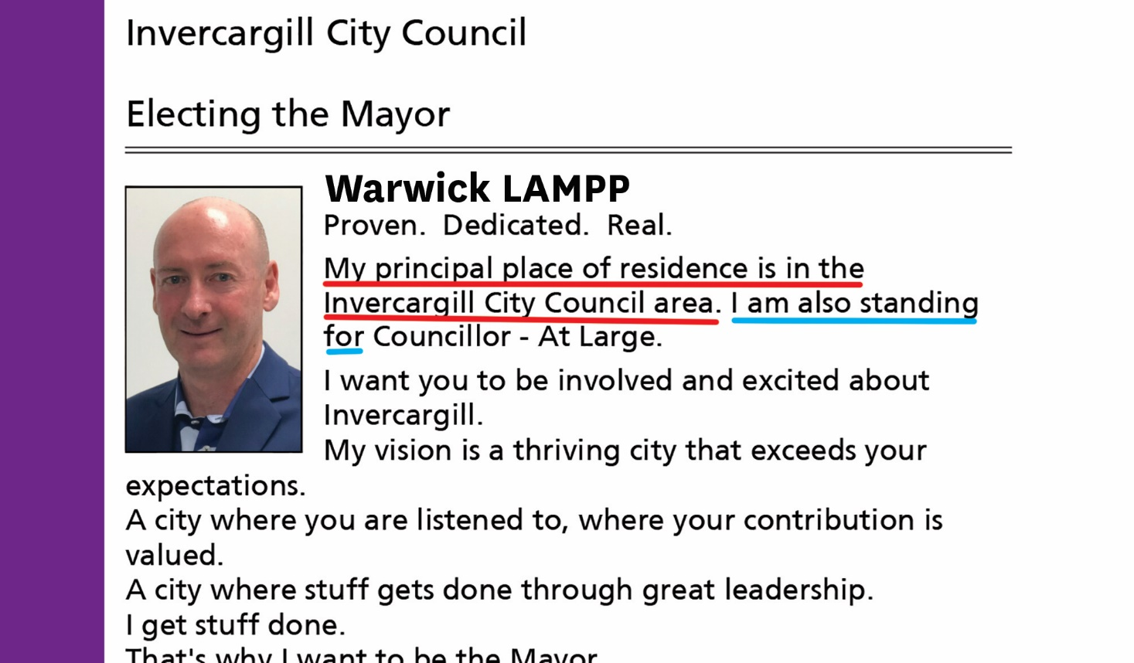
Hei tauira mō te whakaritenga Example Profile Statement
Auto-populated text
Hard-coded text

Slide 27
Whakahaeretia | Campaigning
Can commence any time
Generally no rules around campaigning or conduct, but:
Can’t use council resources for campaigning (logo, branding, colours, council FB or twitter feed, photos, council buildings)
Voting papers should not be collected from electors by candidates or their assistants
No campaigning or electioneering in council chambers or on council premises
Election expenses for campaigning must be recorded and declared in a return after the election
Any campaign material (signs, posters, billboards, flyers, ads, cars, social media) must have an authorisation from the candidate or their agent, stating their name and contact details
Can be address, mobile, email, PO Box
Must be on the front of the sign or promotional material (not the back)
Any content of signs is subject to ASA guidelines and complaints process – must be factual
Usual rules of defamation apply but don’t complain to the EO if you don’t like what someone says about you!

Slide 28
Pae Pāpāho Pāpori | Social Media
Beware of Social Media! During the three-month election period:
Council’s social media channels will unlike / unfollow all candidate social media channels
Candidates must not link their own social media channels (if they are used for campaigning purposes) to the Council’s social media channels, and must ensure that they have the appropriate authorisation
Council social media channels cannot be used for electioneering by candidates or members of the public – will be constantly monitored and strictly enforced
Any post - positive or negative - made by any individual specifically relating to their own or someone else's nomination, intention to run for Council or election campaign, will be removed
Council’s social media channels will remain neutral. Council will promote elections and the importance of voting but will not associate these posts with any candidates
During the lead up to elections, the current Mayor and Councillors may be used in social media posts where it is appropriate and is considered ‘business as usual’ to use them.

Slide 29
Pae Pāpāho Pāpori | Social Media continued
This means, when with the intention of campaigning / electioneering:
No posting on Council pages / accounts
No comments / replies on Council pages
No mentions with a tag (e.g. @NelsonCityCouncil)
No picture tagging
No rating or reviewing Council pages or posts
e.g. you cannot electioneer on Council’s channels, or piggyback on their audiences – see page 22
It is illegal to post a photo of your completed voting paper on FB
If using paid FB advertising, you will have to register as a politician

Slide 30
Ngā Tohu Pōti | Election signs
See page 23 of candidate handbook
Election signs can go up from Monday 8 August (2 months prior to election day)
Must comply with council hoardings policy re size and placement
Maximum of 10 signs per candidate in the city
Can be on private land, but only for 2 months
Waka Kotahi rules apply for State Highways, see page 24
Vehicle signwriting is ok – cost of running a vehicle if it is own personal transport is not an election expense
The cost of framing for a sign is not an election expense
Complaints about size and placement made to council’s Enforcement Officers – not the EO or DEO
Complaints about authorisations to the EO

Slide 31
Ngā Pūtea Koha | Electoral Donations
No time limit on when donations are received, every donation to be recorded
You don’t have to accept a donation – be careful of reason for donation
Must be included in candidate expenditure return
No such thing as an “anonymous” donation if you know who it has come from:
someone can’t give a donation and ask for it to be treated anonymously
anonymous means you don’t know who it came from, can’t reasonably work it out
A third party who passes on a donation must disclose who the donor is
An anonymous donation cannot be over $1,500:
if it is, candidate can’t keep balance over $1,500, it must be given to EO to pass onto council
a donation made up of contributions (e.g. to a trust) is treated as one donation, and can’t be over $1,500 if anonymous
it is an offence to circumvent $1,500 limit, i.e. by deliberately splitting up a donation into smaller contributions.

Slide 32
Ngā Pōti Utu Aukatinga | Election Expenditure Limits
Nelson Mayoralty $30,000
Councillor At Large $30,000
Central Ward $20,000
Stoke-Tāhunanui Ward $20,000
Whakatū Māori Ward $3,500

Slide 33
Ngā Utu Whakahaere | Election Expenses
If standing for more than one position the higher limit applies
The applicable period for which campaign expenditure limits apply is 3 months before election day - 8 July 2022
Candidates required to provide details of electoral expenses incurred before or after the applicable period to Electoral Officer – pro-rata expenses for activity outside the 3 months
Electoral expenses and electoral donation returns required within 55 days after the official result declaration – about 8 December
Deposit not refunded until the return is completed (provided candidate gets more than 25% of the votes of the lowest successful candidate)
Electoral expenses and electoral donations returns are public documents
EO must make expenses documents available on council website for 7 years
See page 19 of the Handbook

Slide 34
Ngā Hēanga Pōtitanga | Election Offences
See page 37
Imitation Voting Paper – examples next slide
Bribery
Treating
Can’t provide food, alcohol, drinks, entertainment as an inducement to vote (light refreshments after a meeting is ok)
Can’t give away a pen, note pad, fridge magnet or item of value
Undue Influence – cant stand over someone telling them how to vote, or post or deliver someone else's voting paper
Unauthorised advertisements
Illegal nomination – e.g. candidate with a court order
Any formal complaint passed straight to the Police

Slide 35
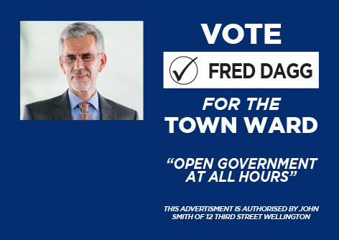
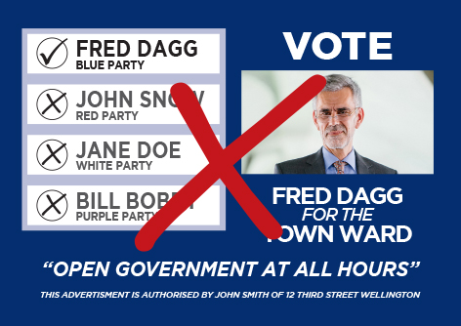
Ngā Tohu Pōti | Example of Signs

Slide 36
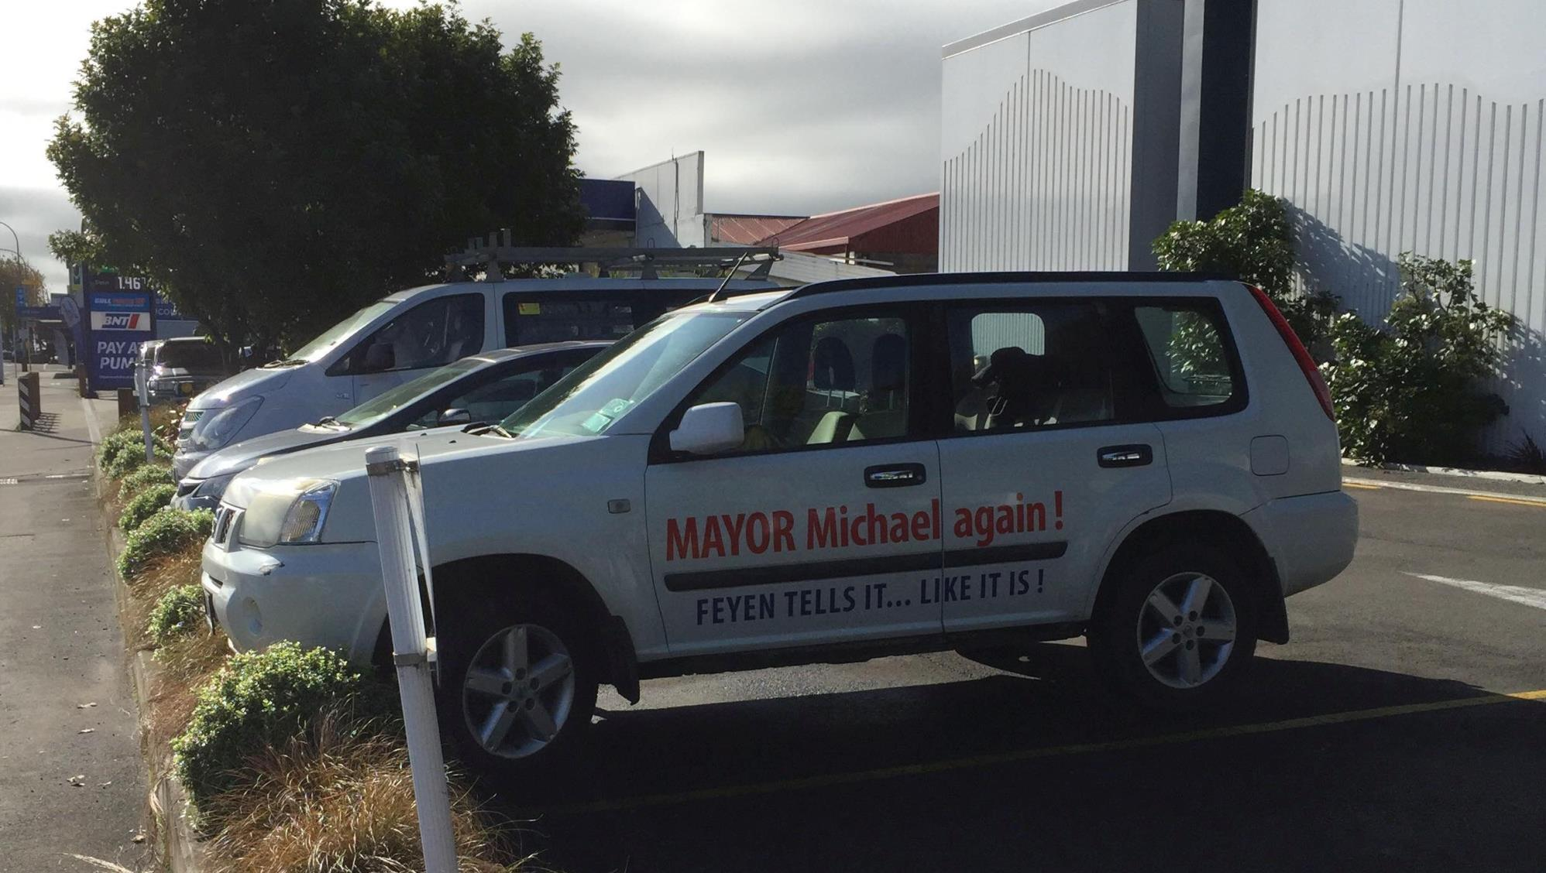

Slide 37
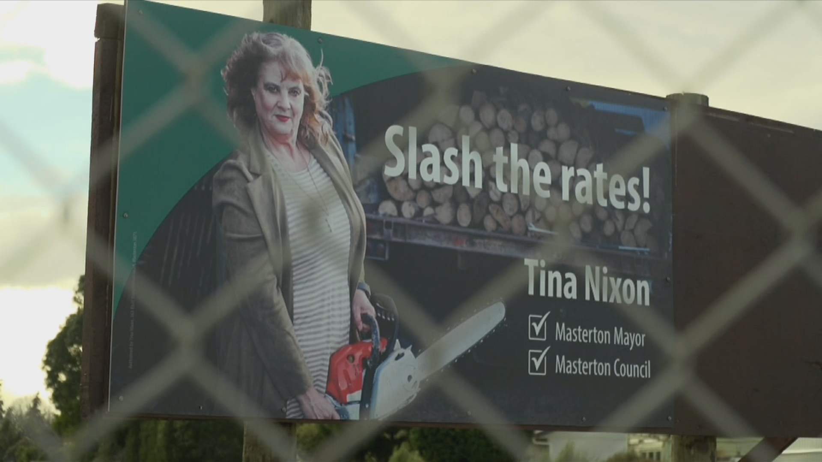

Slide 38
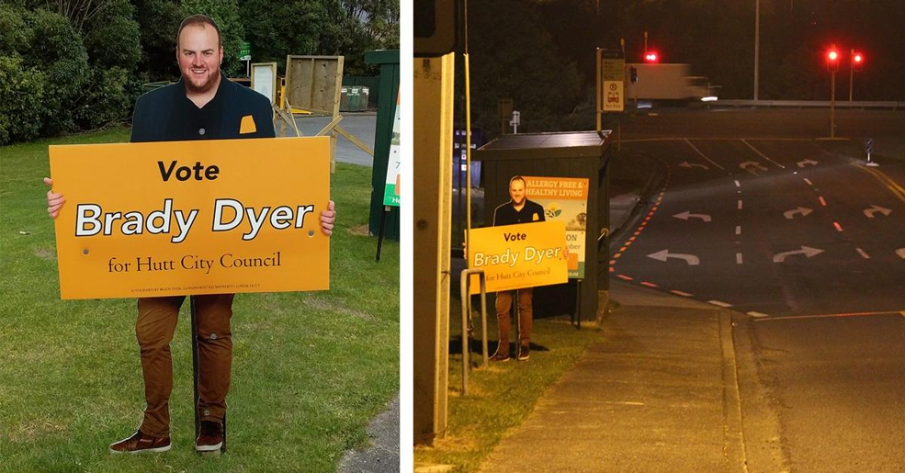

Slide 39
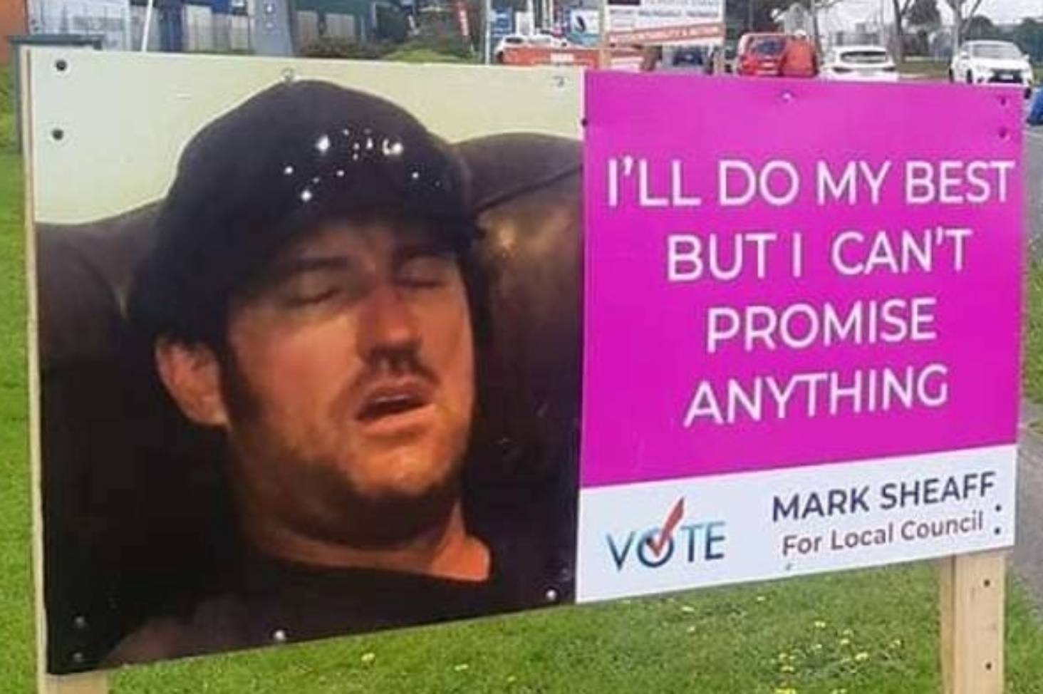

Slide 40
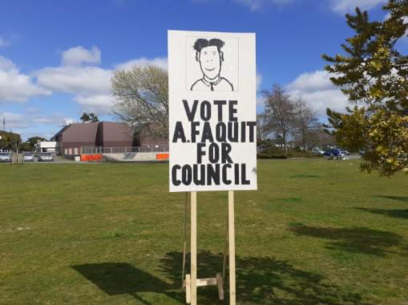

Slide 42
Rārangi Pukapuka Pōti | Electoral Rolls
Preliminary Electoral Roll
available for public inspection from 15 July to 5pm Friday 12 August 2022
at all libraries and the council office
includes the ratepayer roll
Cannot be provided electronically to candidates
Final Electoral Roll
produced following the EC update campaign
is the roll used for issuing voting papers
can purchase hard copy for $100 (plus GST) for full roll or $50 per ward

Slide 43
Pōti Motuhake | Special Voting
Available for anyone who spoils, loses, or does not receive their voting paper or enrols after 12 August
Available for electors on the unpublished roll
Available from 16 September to 12 noon on election day, 8 October 2022
Available at NCC office, or can be posted out
At NCC office on Saturday 8 October
Applicants can come in or contact DEO by phone or email
Candidates cannot collect special voting documents on behalf of electors

Slide 44
Otinga Pōtitanga | Election Results
Preliminary count occurs from 12 noon, Saturday 8 October 2022
Progress results: expected about 3pm – approx 90% of votes received (not special votes and votes in transit to processing centre).
Progress results:
Will be available from council’s website
email to all candidates with email address
Candidates personally rung by council staff
Preliminary results: expected late on Sunday 9 October, after all ordinary votes have been processed
Final results: expected by Thursday 13 October, after special votes have been processed

Slide 45
Nau mai ki te tari | Coming into Office
All members come into office on the day following the day on which the candidates are declared to be elected
This is the day after the result declaration is posted on council’s website - expected to be Friday 18 or Saturday 19 October
Successful candidates contacted by mayor/staff
Council’s inaugural meeting and the “swearing in” of elected members (elected candidates cannot act until this has occurred)

Slide 46
Rauemi | Resources
Candidate Handbook and nomination papers
LGNZ 'Making a Stand' booklet
Council’s Pre-election report – available from 1 August 2022:
To inform the community and candidates on key aspects of Council business
To set out major projects and expenditure for next 3 years
To promote discussion on issues and inform any elections debate
Legislation (LEA, LER)
Council's website (for election information): www.nelson.govt.nz

Slide 47
Kupu Whakamutunga | Last word
No Online Voting
Campaigning – anything goes
Election results – on websites/email – progress/prelim/final
Election day – Saturday 8 October 2022
Good luck!!

