Slide 1
Housing in an Ageing Society
Kay Saville-Smith Bev James
CRESA Public Policy & Research
Presentation to Housing Stakeholders
Nelson, 18 September 2017

Slide 2
What we will cover today
Housing trends in Nelson and Tasman
Research themes and findings:
Housing that older people want
The importance of repairs and maintenance
The importance of resilient housing
Downsizing – things to think about
What does this mean for Nelson and Tasman
What can housing stakeholders do
Information and decision-support tools for making housing decisions

Slide 3
Good Homes Research Programmes
Good Homes Ageing in Place
Community Resilience and Good Ageing
Finding the Best Fit: housing, downsizing and older people
Life When Renting
Supporting older people’s resilience in homes and communities
Understanding older people’s experiences and points of view
Multi-method, multi-disciplinary
Evidence-based solutions

Slide 4
Housing trends in Nelson & Tasman
Big Issues in housing:
Declining home ownership
More renting among older population
Uncontrolled house prices
Poor stock alignment
Unaffordability owner occupation and unaffordable rentals
Poor stock maintenance
Poor resilience
Low take-up of LifeMark
Older people are affected by these
Hard to down size
Increased rates – this is largely house price driven
Unaffordable rents
Insecurity
Poor housing conditions
Inaccessible and dysfunctional dwellings
Notes:
Sever weather – Office of the Chief Science Advior

Slide 5
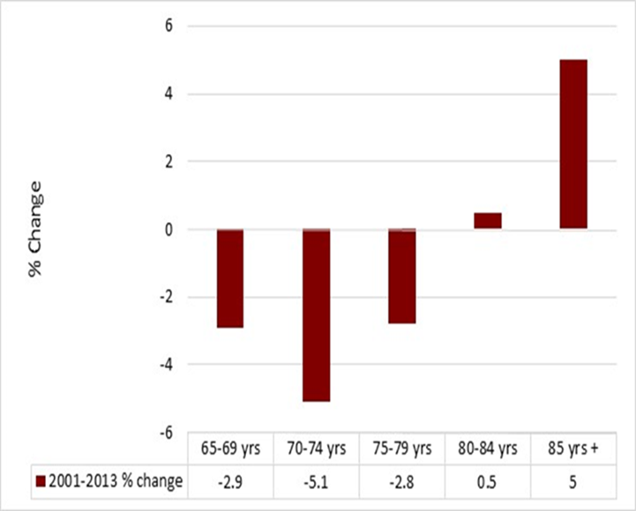
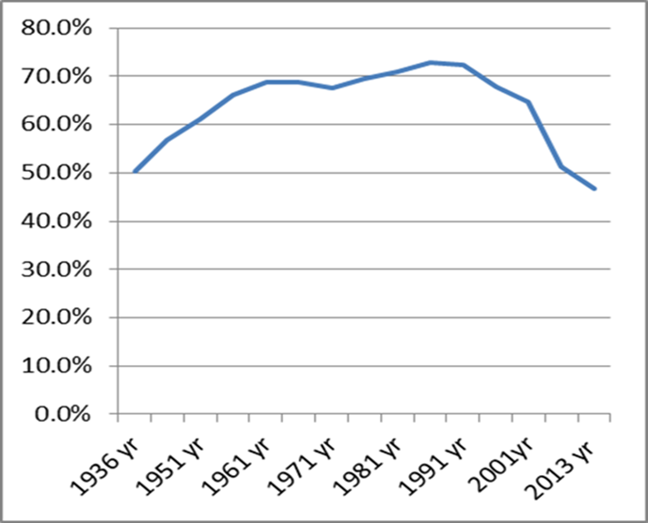
Declining Owner Occupation - NZ

Slide 6
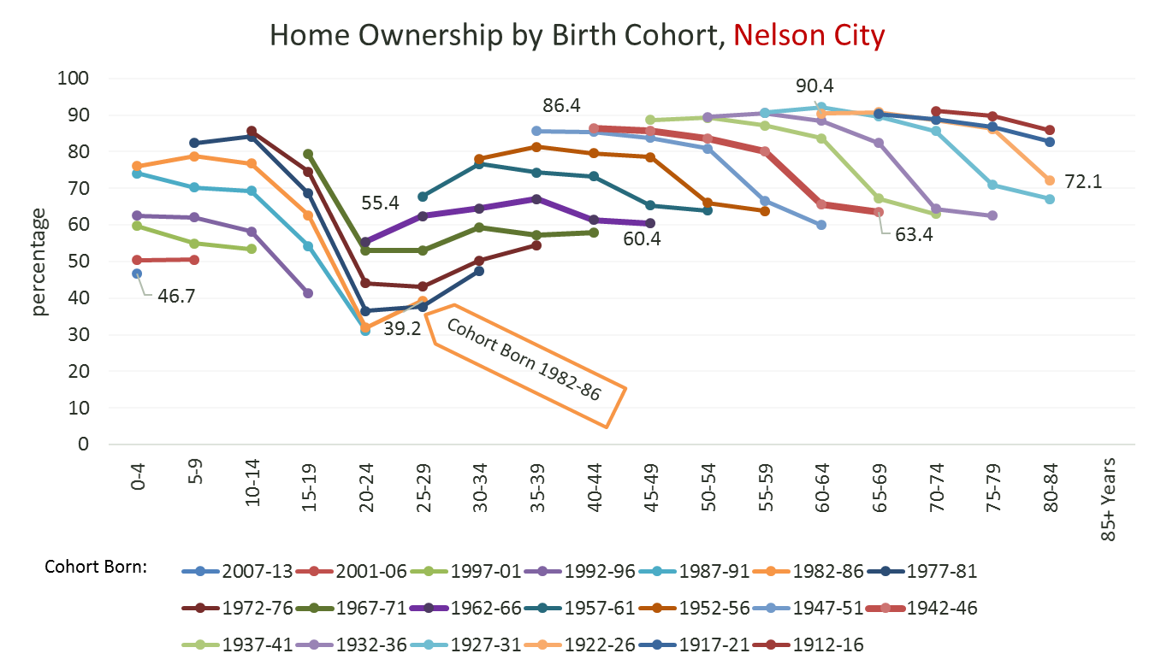
Source: Natalie Jackson

Slide 7
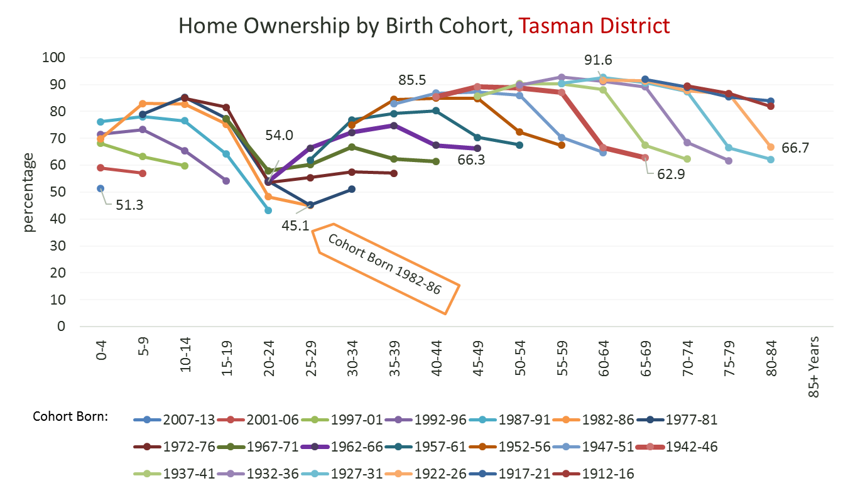
Cohort Born 1962-66 (youngest ‘Boomers)
Cohort Born 1942-46 (oldest ‘Boomers’)
Leave parental home
Main family formation years

Slide 8
High House Prices Don’t Always Help – Sale and Purchase Among Older Movers

Slide 9
Housing Stock Does not Accommodate Downsizing

Slide 10
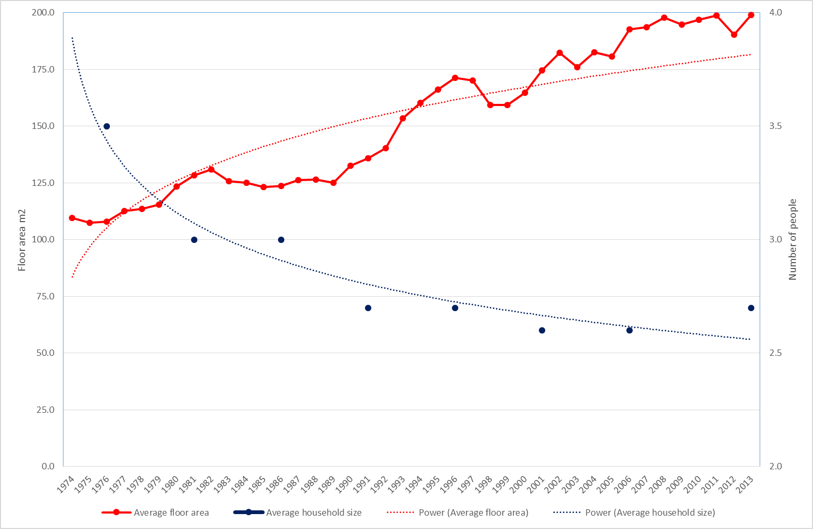
House size & household size

Slide 11
Accommodation Supplement – A measure of Rental Unaffordability
 | Number aged 65+ Renting with AS | Number aged 65+ Owner-occupier with AS | Number aged 65+ Boarding with AS | Total | Renters receiving AS as % of all renters 65+
Nelson City | 293 | 75 | 34 | 402 | 38%
Tasman District | 268 | 58 | 24 | 350 | 44%
Marlborough District | 361 | 73 | 25 | 459 | 45%
NZ | 26295 | 6744 | 3752 | 37446 | 40%
 | Number Renting with AS | Number Owner-occupier with AS | Number Boarding with AS | Total | Renters receiving AS as % of all renters 65+
Nelson City | 293 | 75 | 34 | 402 | 38%
Tasman District | 268 | 58 | 24 | 350 | 44%
Marlborough District | 361 | 73 | 25 | 459 | 45%
NZ | 26295 | 6744 | 3752 | 37446 | 40%
Notes:
Source: 2013 census and MSD AS data 2016.

Slide 12
Older Renters Have Particular Needs

Slide 13
Older people Want Fit for Purpose Homes
Most older people don’t want to move – Our downsizing research shows:
78% had not moved in recent past and had no intention of moving
Those that move are looking for:
Less house and section maintenance
Cheaper house running costs
Lifestyle improvement
Health and mobility concerns
Financial concerns
Closer to services
Closer to family or ‘back home’
Notes:
National R&M survey n=1600.

Slide 14
Under maintained houses – not safe or comfortable
Average value of older householder owner occupiers unmet repairs to bring to ‘new’ = $9,000 (2010/11)
34% reported problems with mould, damp, condensation
25% reported a slip or fall around home
Deferral of repairs and maintenance due to expense, inconvenience, difficulties in obtaining trusted provider
Unaddressed repairs and maintenance:
Health risks
Safety risks
Premature move to aged residential care
Notes:
National R&M survey n=1600.

Slide 15
Older People need resilient homes
A home resilient to adverse natural events:
Protects the residents
Minimises damage
Minimises costs and time in recovery and repairing damage
Older people a very vulnerable
Physiologically
Financially
Older people a huge resource for communities preparing, responding to and recovering from adverse events – So homes need to be resilient

Slide 16
Downsizing has Pros and Cons
Pros
Improved dwelling performance and condition
Improved physical and mental health
Releasing capital to deal with mortgage, debt
Lower running costs
Maintain or improve connections

Slide 17
The downsides of downsizing
The Cons
House prices
Moving costs
Unexpected costs
Divesting possessions – both good and bad experiences
Adjusting to new life, new environment
Housing preferences are not met by the market
Smaller size
Close to services
Accessible features

Slide 18
Equity release is not that simple
The two main pathways are fraught with difficulty:
Reverse equity lending
Movement to a lower cost dwelling
All sorts of shocks can de-rail things:
Adverse natural events
Adverse financial events – abuse, company collapse
Leaky building syndrome
High house prices do not inherently deliver opportunities for equity release

Slide 19
Capital Equity Release is Modest
Substantial proportion of movers in the open market were left with a surplus of less than $50,000
Movers to retirement villages tend to:
Face higher costs
Face non-discretionary costs
Were very much wealthier in the first place
Notes:
550 older people community-based – 115 movers/435 stayers – Downsizing Survey
615 older people in retirement villages(RVs) – Downsizing Survey

Slide 20
Expectations and Realisations Ownership and License to Occupy

Slide 21
What does this mean for Nelson & Tasman?
Increasing older population
Probable decreasing aggregate population
Nelson and Tasman dependent on older people’s well-being and productivity
Declining home ownership, increasing renting
Population vulnerability in adverse natural events
Downsizing needs to be made real and positive

Slide 22
Fit for Purpose Housing in an Ageing Society
House design is crucial – Lifemark, Homestar and resilience
Diversifying the stock and tenure
Affordability cannot be ignored
Location is critical
Resilience
Independence
Contribution – social and economic
Public transport and compact settlement investment

Slide 23
Opportunities for better services
Support services linked with housing
Connecting across sectors – housing providers, home care services, transport, health services, addressing elder abuse and isolation
Best practice information and tools for the provision of rental housing for older people
Housing provider partnering – community sector and private property investors
Developing naturally occurring retirement communities

Slide 24
Tools Based on Research Findings
Older people want to be actively involved in decision-making about their home-related needs
Home-related decisions are complex:
Staying put or moving?
Is this a vulnerable site?
What are the financial implication of my choice?
Could I manage here with some help?
What are my future needs?
Potential danger of jumping to the ‘solution’ before understanding the ‘problem’

Slide 25
Four Tools
Good Homes – repairs and maintenance identification and solutions
Resilient Homes – resilient dwelling design, materials and systems identification
Selecting a Site for Your Home – residential site vulnerability identification
My Home My Choices – home-related options identification and decision-support
Solutions co-designed with older people and service providers

