Slide 1
23 HALIFAX STREET DECONSTRUCTION
  Working together to make Nelson an even better place

Slide 2
23 HALIFAX STREET DECONSTRUCTION
Key Deliverables
Removing an earthquake prone building by January 2022
Works to be undertaken in a way that minimised environmental impact (recycling & repurposing building materials as much as possible)
  Working together to make Nelson an even better place

Slide 3
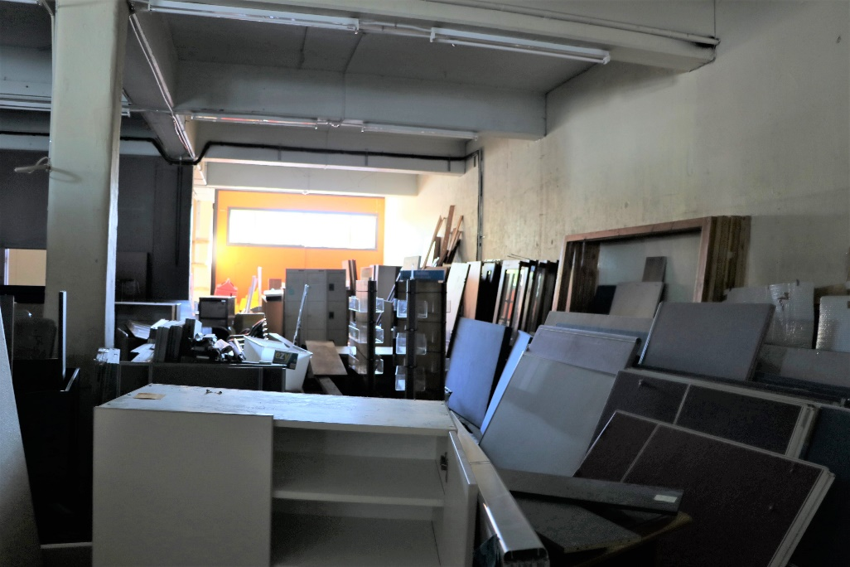
23 HALIFAX STREET DECONSTRUCTION
Stored Furniture Removed
Before
The former Mediterranean Warehouse was being used as a very congested storage unit.
Furniture and unclaimed items went to RE:Store, Habitat for Humanity, Nelson Environment Centre, MenzShed and Founders Park.
  Working together to make Nelson an even better place

Slide 4
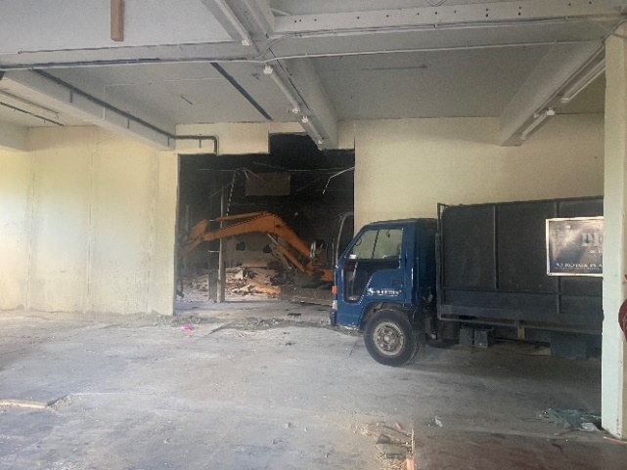
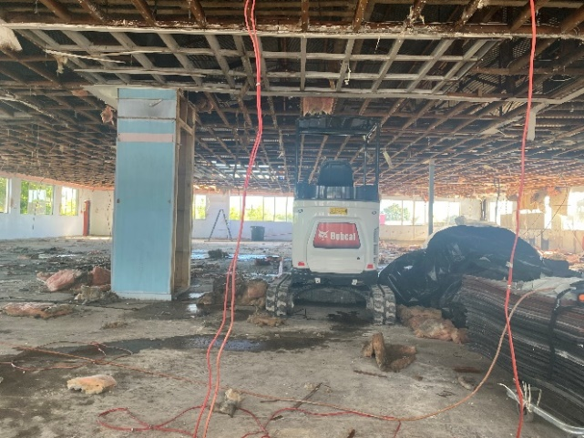
23 HALIFAX STREET DECONSTRUCTION
Stage 1 – Internal Strip Out & Asbestos Removal
Stage 1 entailed:
The removal of the intertenancy wall
Removal of the internal linings
Removal and disposal of any hazardous materials
  Working together to make Nelson an even better place

Slide 5
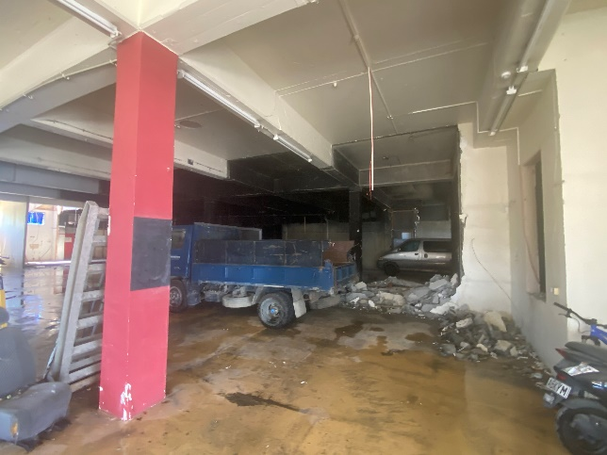
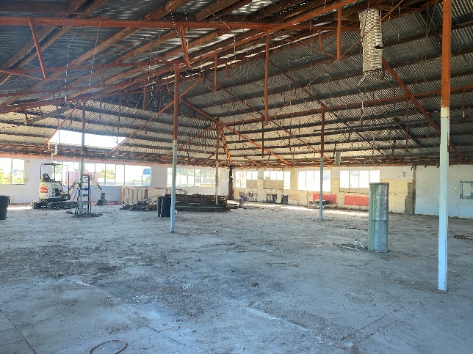
23 HALIFAX STREET DECONSTRUCTION
Stage 1 – Resource Recovery
16 tonne of scrap metal was taken to SIMS Pacific Metal (copper insulation, stainless steel, aluminium and light gauge metal)
5 truckloads of fittings and fixtures were carted to RE:Store
The freezer panel walls and ceiling that was in the Mediterranean Food Warehouse went to a lifestyle property where it will commence a new life as a homekill shed.
16 tonne of gib was carted to local farms where it is crushed and used on crops as a source of lime.
2 truckloads of broken timber to be dispensed as firewood.
1 truckload of timber purlins (in good condition) were carted to Norwest Timber Recycling for reuse.
480 m3 of concrete was removed for crushing and re-use
44 tonne of waste was carted to York Valley landfill facility.
1.3 tonne of contaminated waste was removed from site.
  Working together to make Nelson an even better place

Slide 6
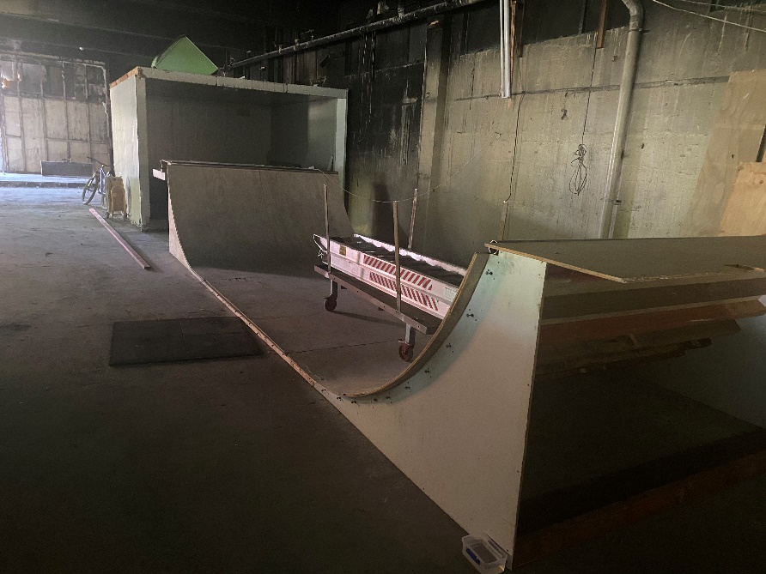
23 HALIFAX STREET DECONSTRUCTION
Stage 1 – Resource Recovery
Thinking outside the square!
Norwest Demolition crew created this skateboard ramp from discarded timber (too good for firewood but not good enough for building) along with some melamine scraps.
All they needed to purchase were screws and a couple of sheets of ply.
  Working together to make Nelson an even better place

Slide 7
23 HALIFAX STREET DECONSTRUCTION
Stage 1 – Resource Recovery
Network with your local community!
Nayland Scaffold had mentioned to a local contact that the entire building at 23 Halifax Street was being repurposed/recycled. That local contact was someone connected with Kohatu Raceway. They were seeking to build some new culverts.
The beams from the old Mediterranean Food Warehouse became the new culverts at Kohatu Raceway.
Nothing goes to waste!
  Working together to make Nelson an even better place

Slide 8
23 HALIFAX STREET DECONSTRUCTION
Stage 2 – Deconstruction of the Building Shell
Deconstruction of the building shell commenced 9 February 2021.
Scaffolding to the street frontages erected then roof iron & trusses removed.
The deconstruction of the building happened systematically as per the grid plan shown on this slide. The first floor and mid floor sections were removed before the ground floor.
The concrete was sawcut into sections then lifted by crane to the inside of the building.
The wall closest to the library provided some noise insulation throughout deconstruction and was the last to be removed.
  Working together to make Nelson an even better place

Slide 9
23 HALIFAX STREET DECONSTRUCTION
Stage 2 – Proposed Resource Recovery
Building Element | Destination
Roofing iron | If in reasonable condition – Habitat for Humanity/ RE:Store If beyond repair – SIMS Pacific Metal
Red Lead Coated Trusses | If in reasonable condition – Habitat for Humanity If beyond repair – SIMS Pacific Metal
Concrete | Transported to Harveys Landfill (Cable Bay) to be crushed into engineered fill
Windows | If in reasonable condition – Habitat for Humanity/ RE:Store If beyond repair – SIMS Pacific Metal
Roller Door | If in reasonable condition – Habitat for Humanity If beyond repair – SIMS Pacific Metal
Structural Steel | If in reasonable condition – Habitat for Humanity If beyond repair – SIMS Pacific Metal
Reinforcing Steel | SIMS Pacific Metal
  Working together to make Nelson an even better place

Slide 10
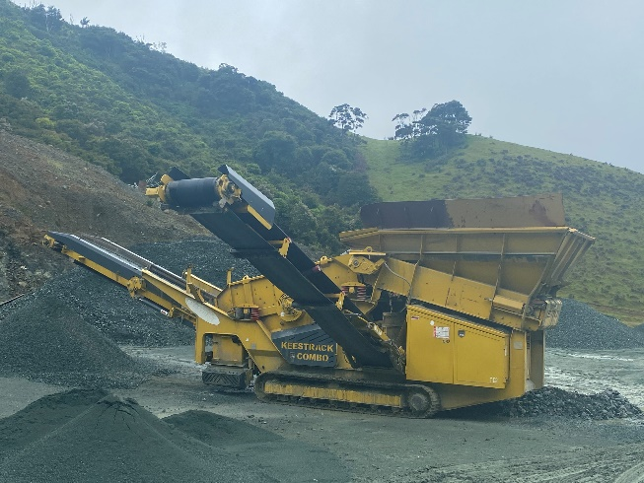
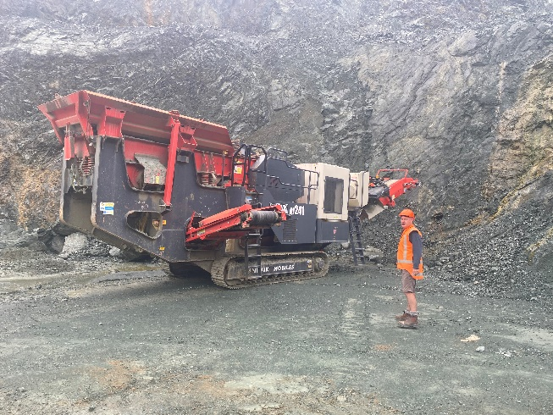
23 HALIFAX STREET DECONSTRUCTION
How will the crushed concrete be used?
The concrete was crushed to specified engineered fill to be potentially used as follows:
To raise building floor levels as they are currently doing at Cawthron Institute & LQS Estate (Richmond)
Forestry roads
Sub-base for access ways if approved by NCC
  Working together to make Nelson an even better place

